Slide 1
CLASS 20,21
Dated 2 April, 2025
Course Title: 5G and Wireless Technology
Course Code : ECE829
MODULE 1 of the Syllabus:-
Mobile Generations _1G to 5G and 5G Smart ANT_Beamforming
Prof.(Dr.) Rabindranath Bera (Professor, IIIT, KALYANI)
E-mail: rbera@iiitkalyani.ac.in; Mobile : 9475513358
i

Slide 2
Outline of Presentation
Mobile Generations from 1G to 5G
5G Smart ANT_Beamforming
Commercial availability of smart antenna for 5g/6G mobile uses
What is Smart antenna?
Types
Advantages and Limitation
Smart Antenna Uses in ofdm and 5G/6G

Slide 3
Mobile Generations from 1G to 5G

Slide 4
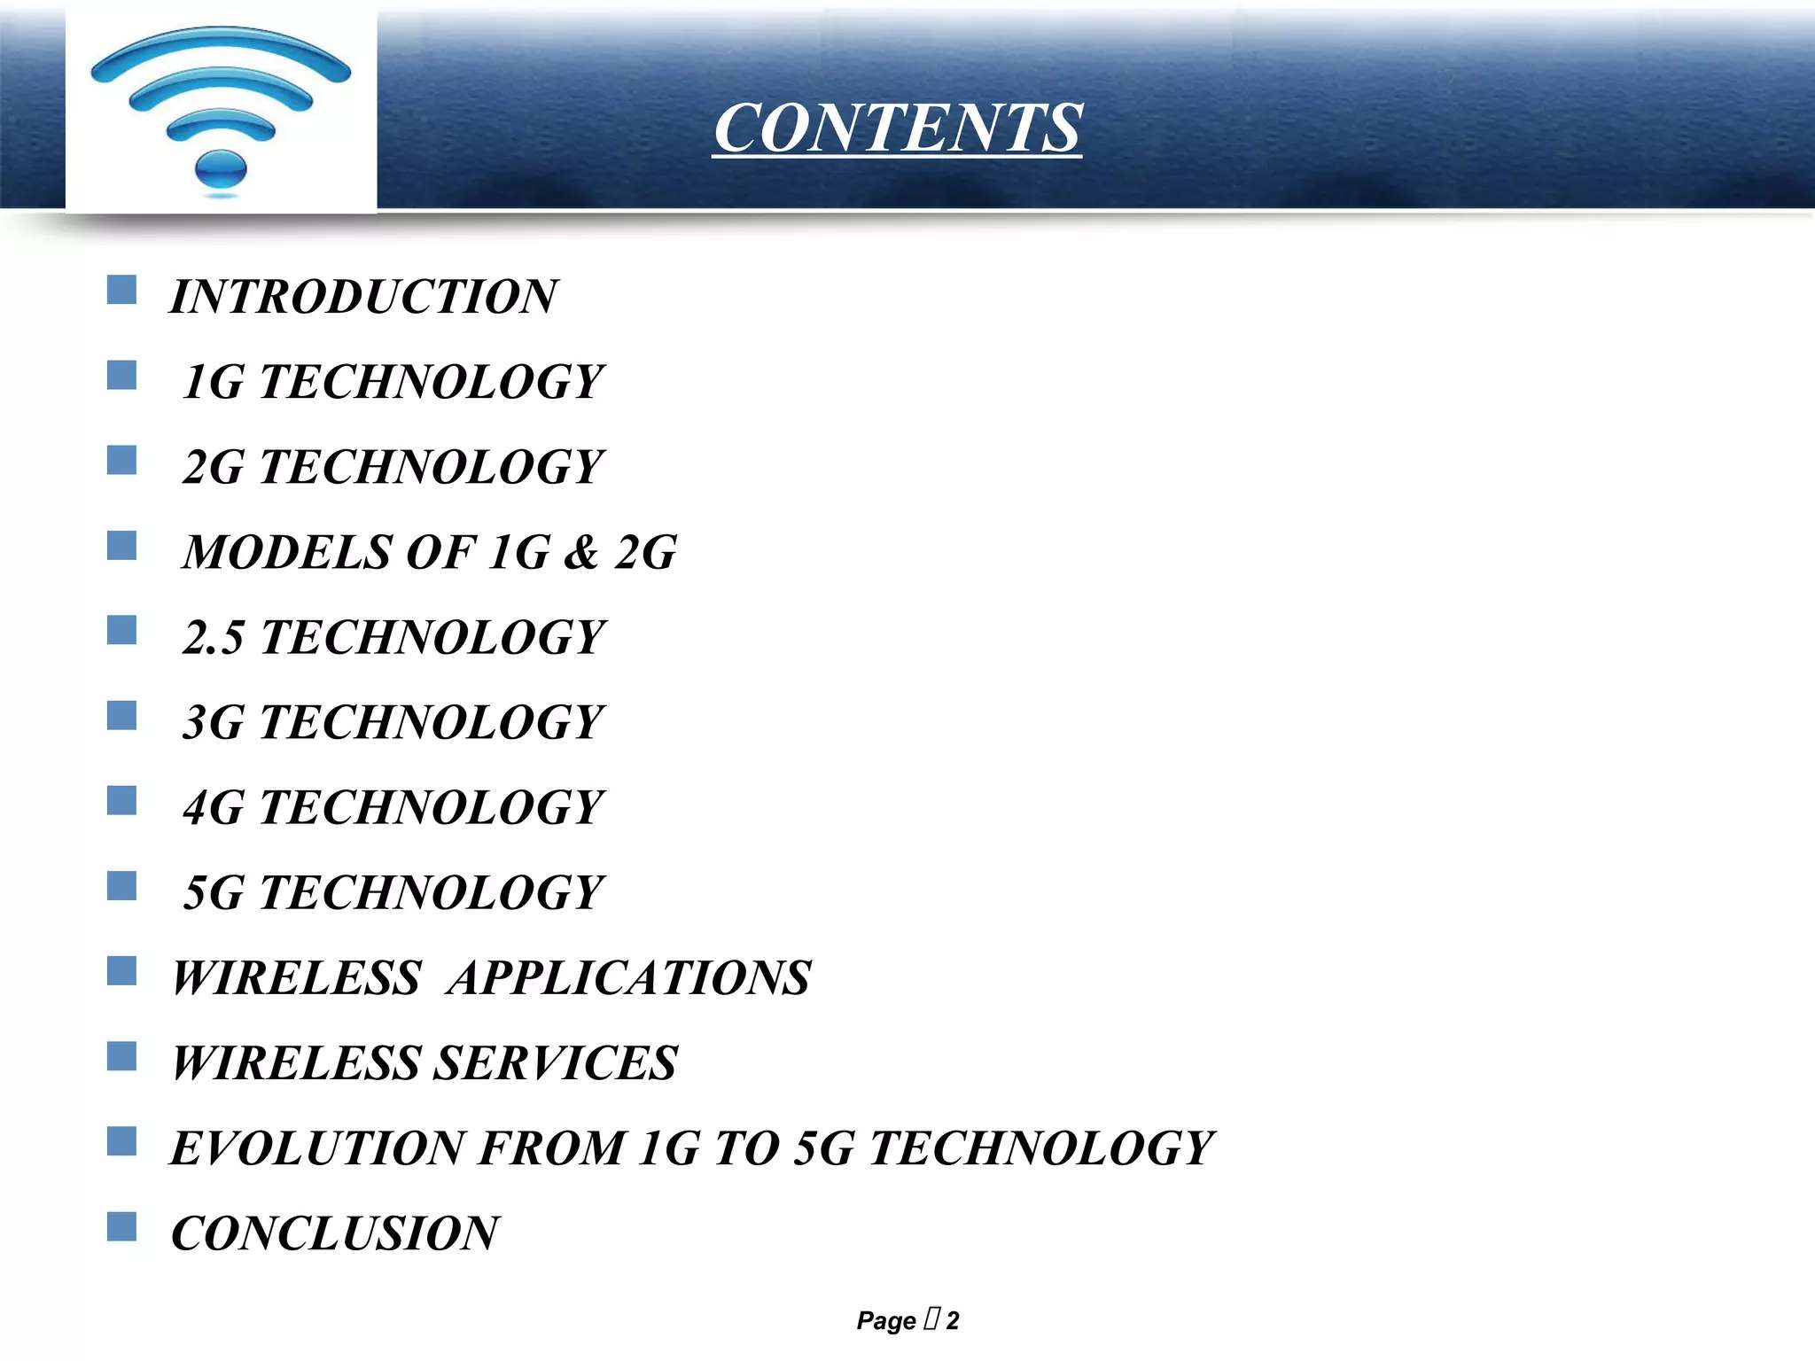

Slide 5
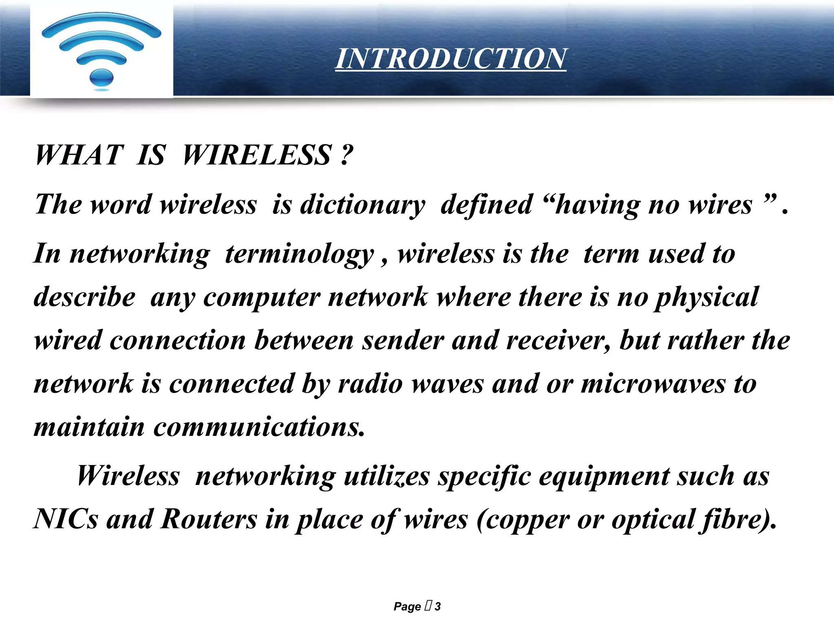

Slide 6
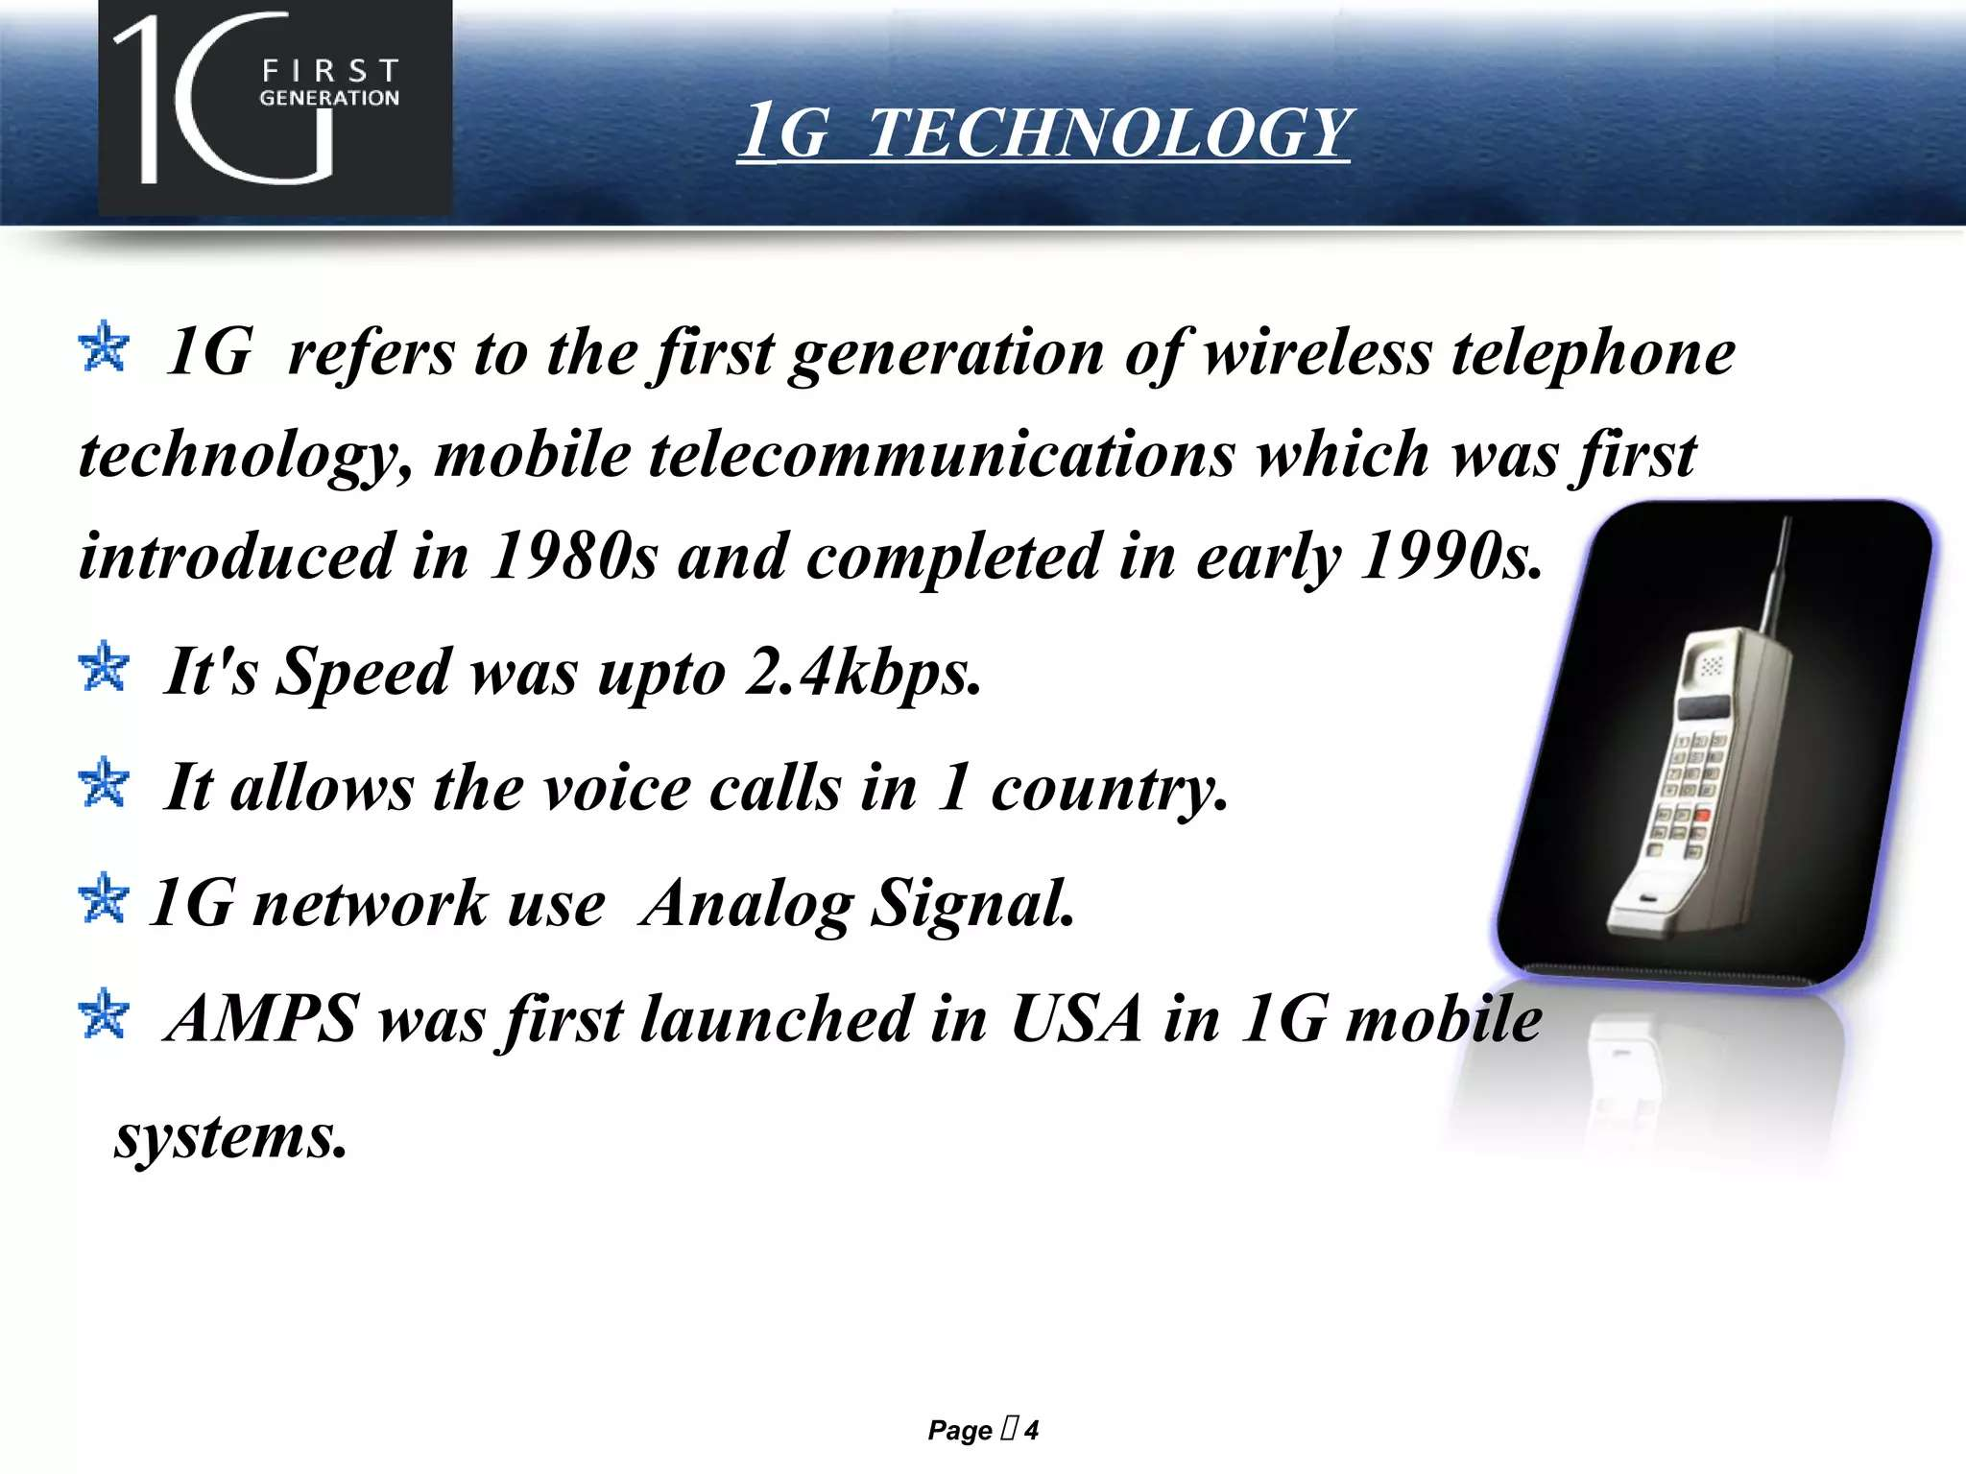

Slide 7
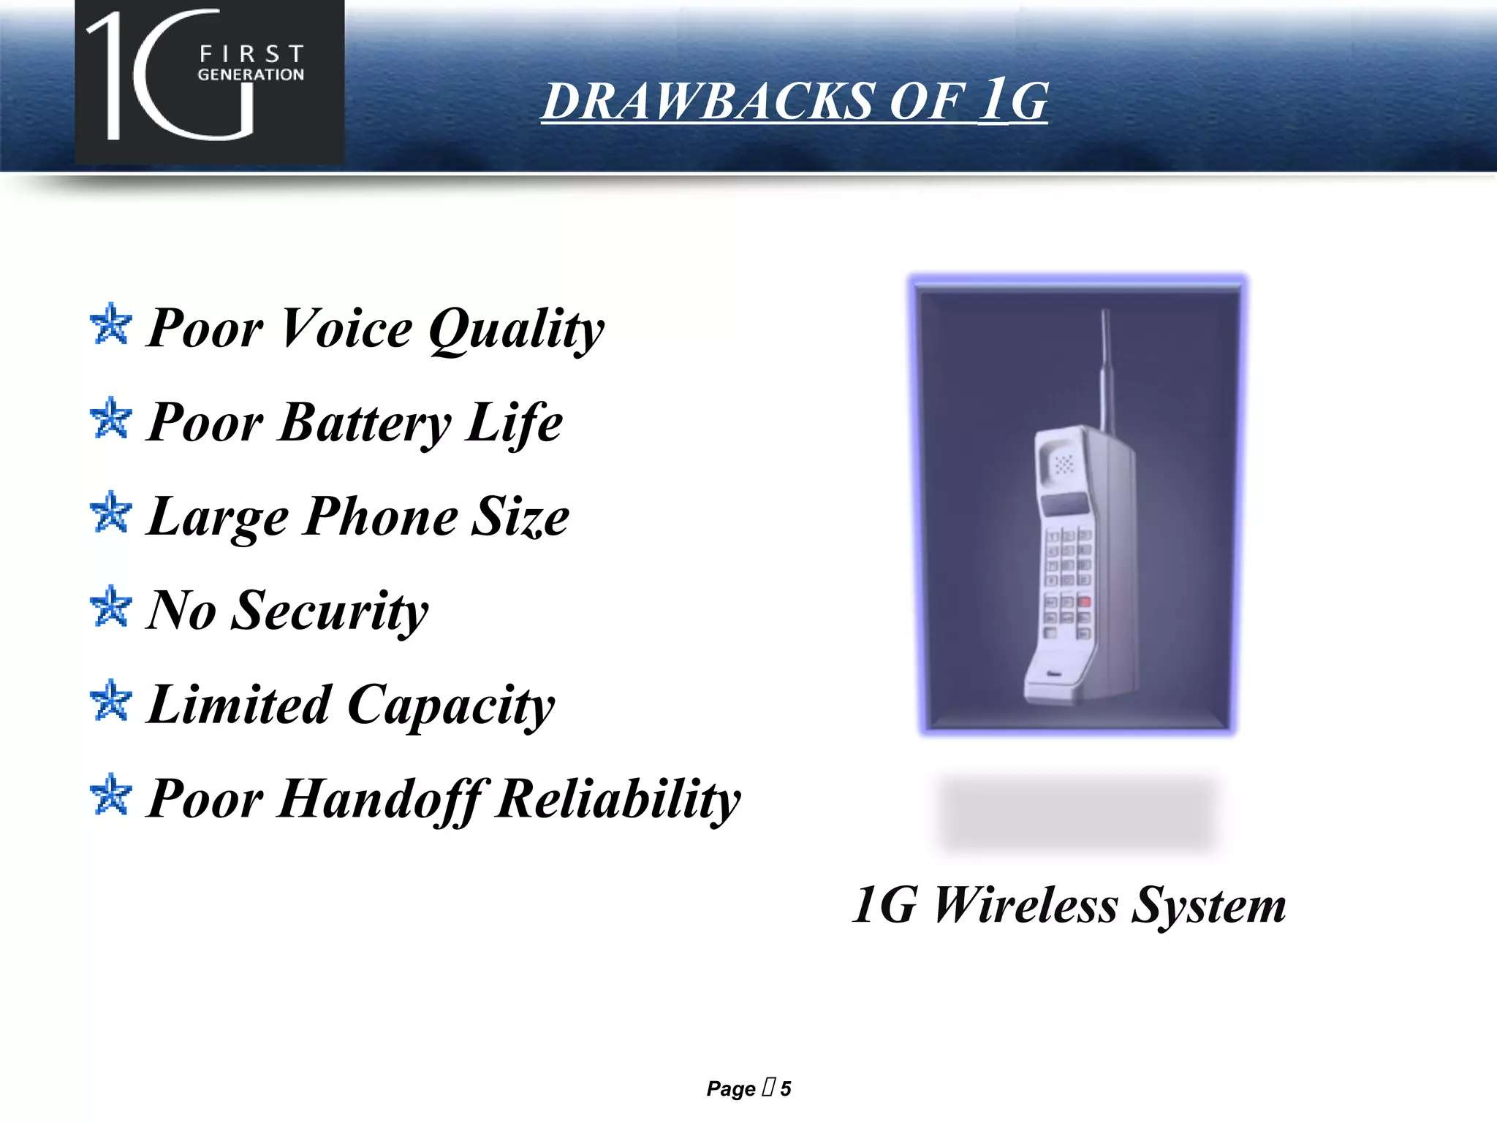

Slide 8
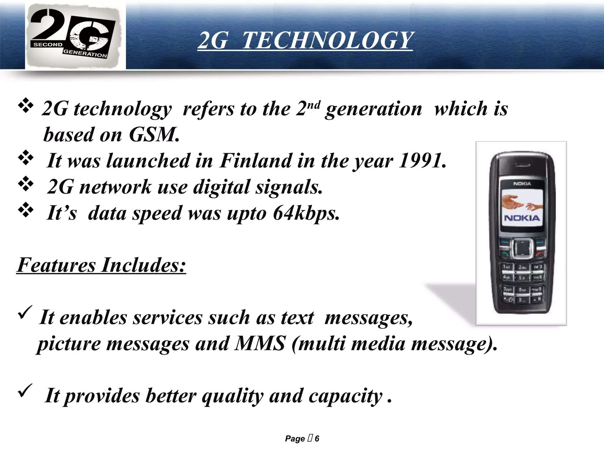

Slide 9
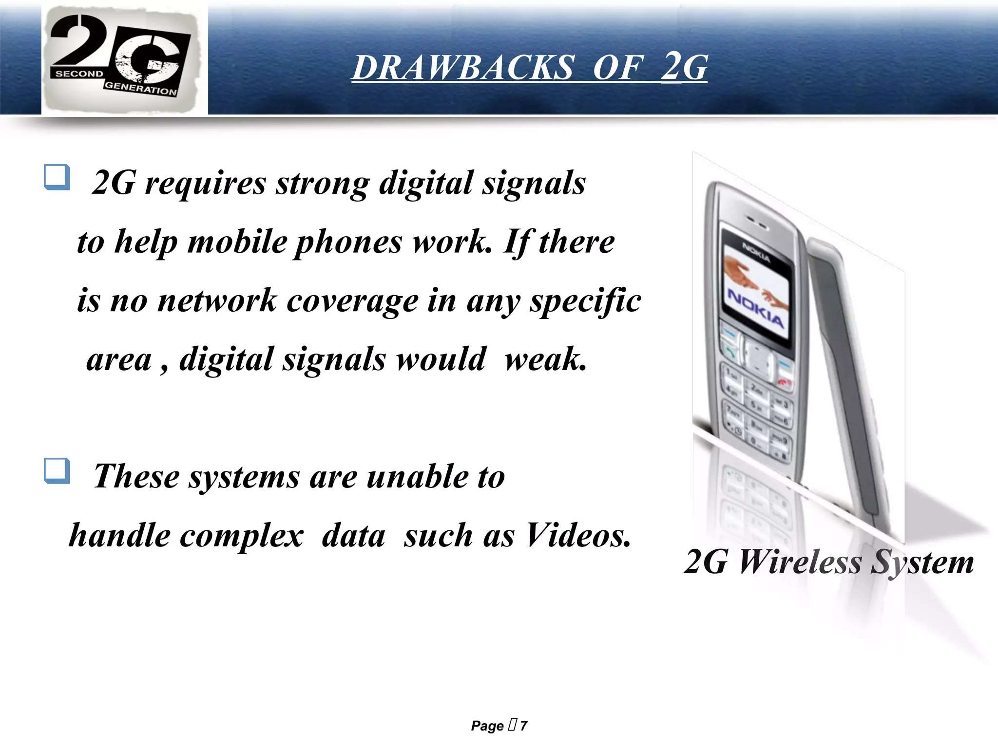

Slide 10
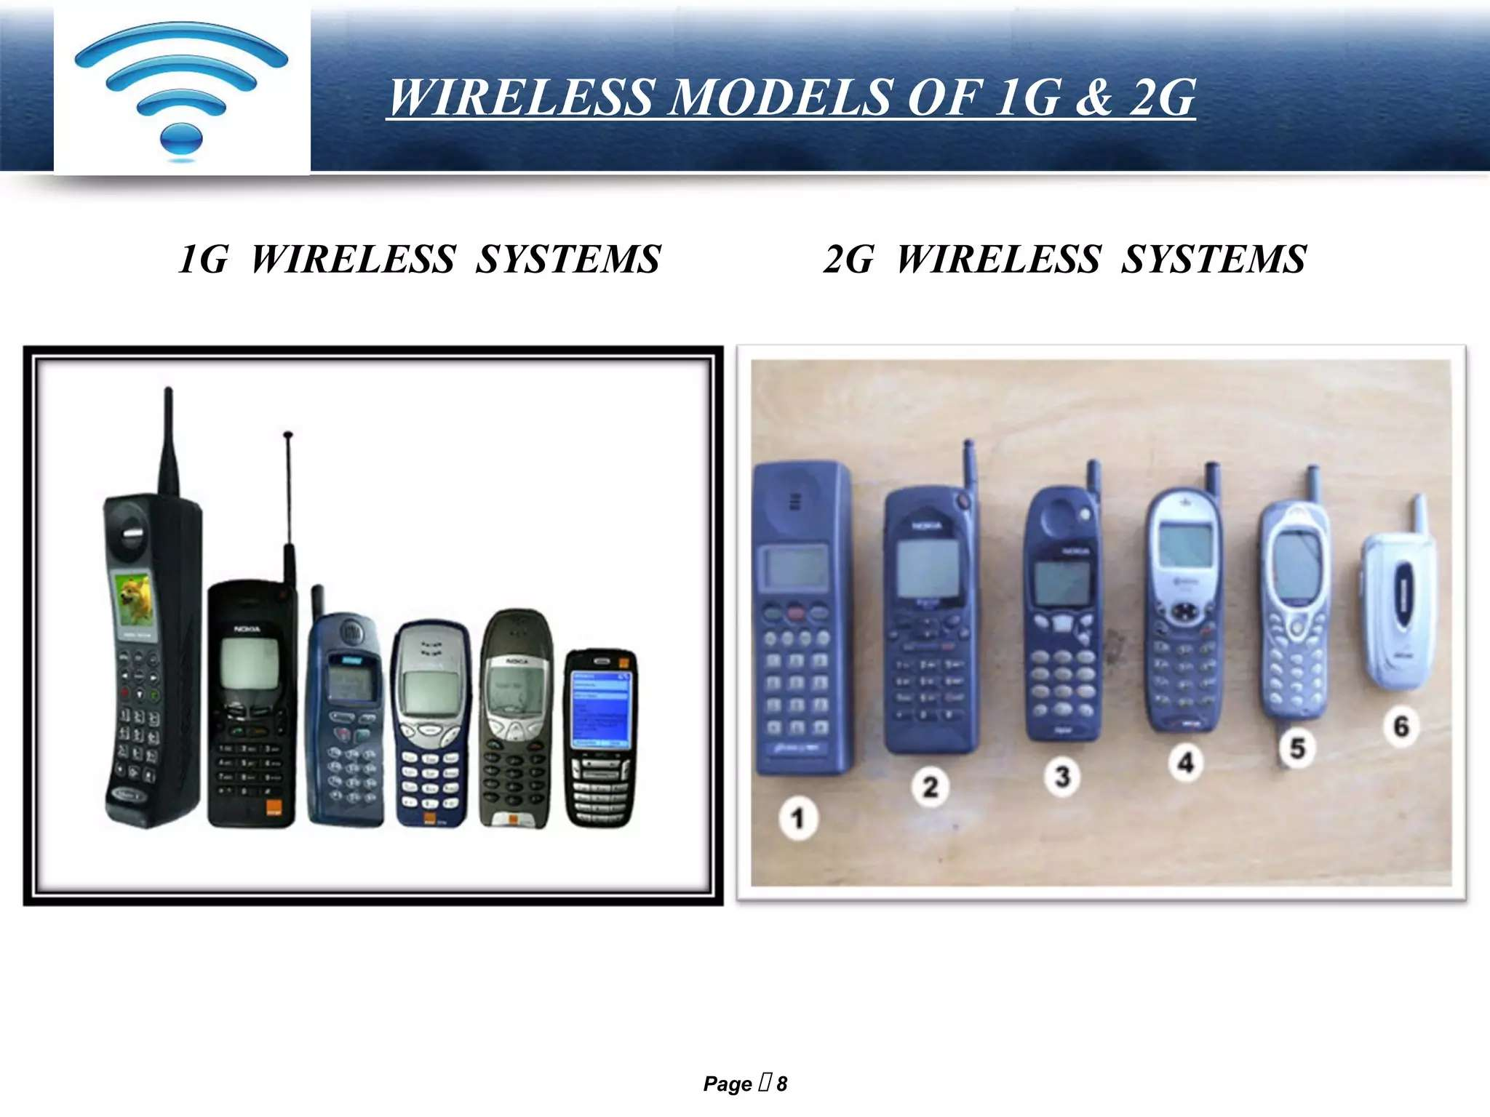

Slide 11
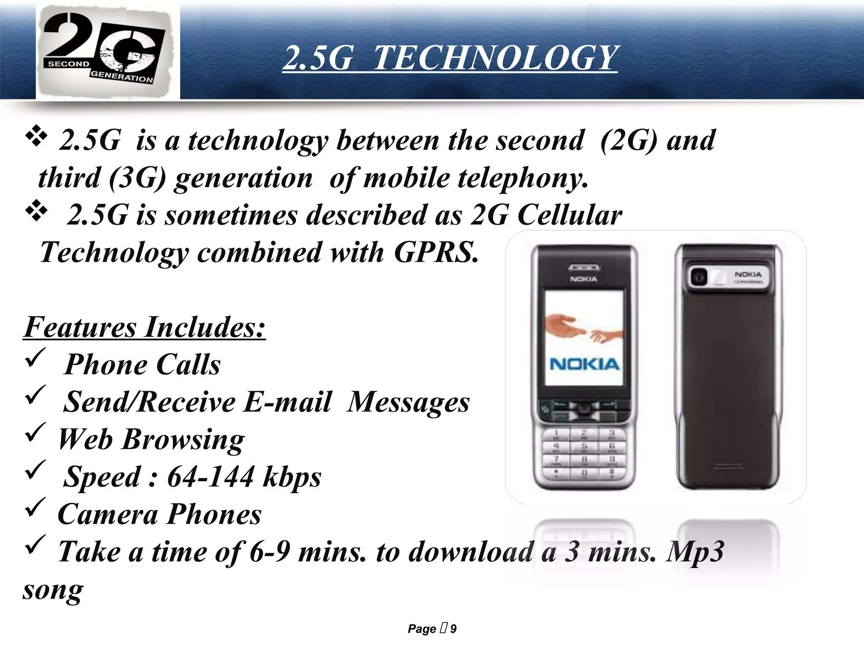

Slide 12
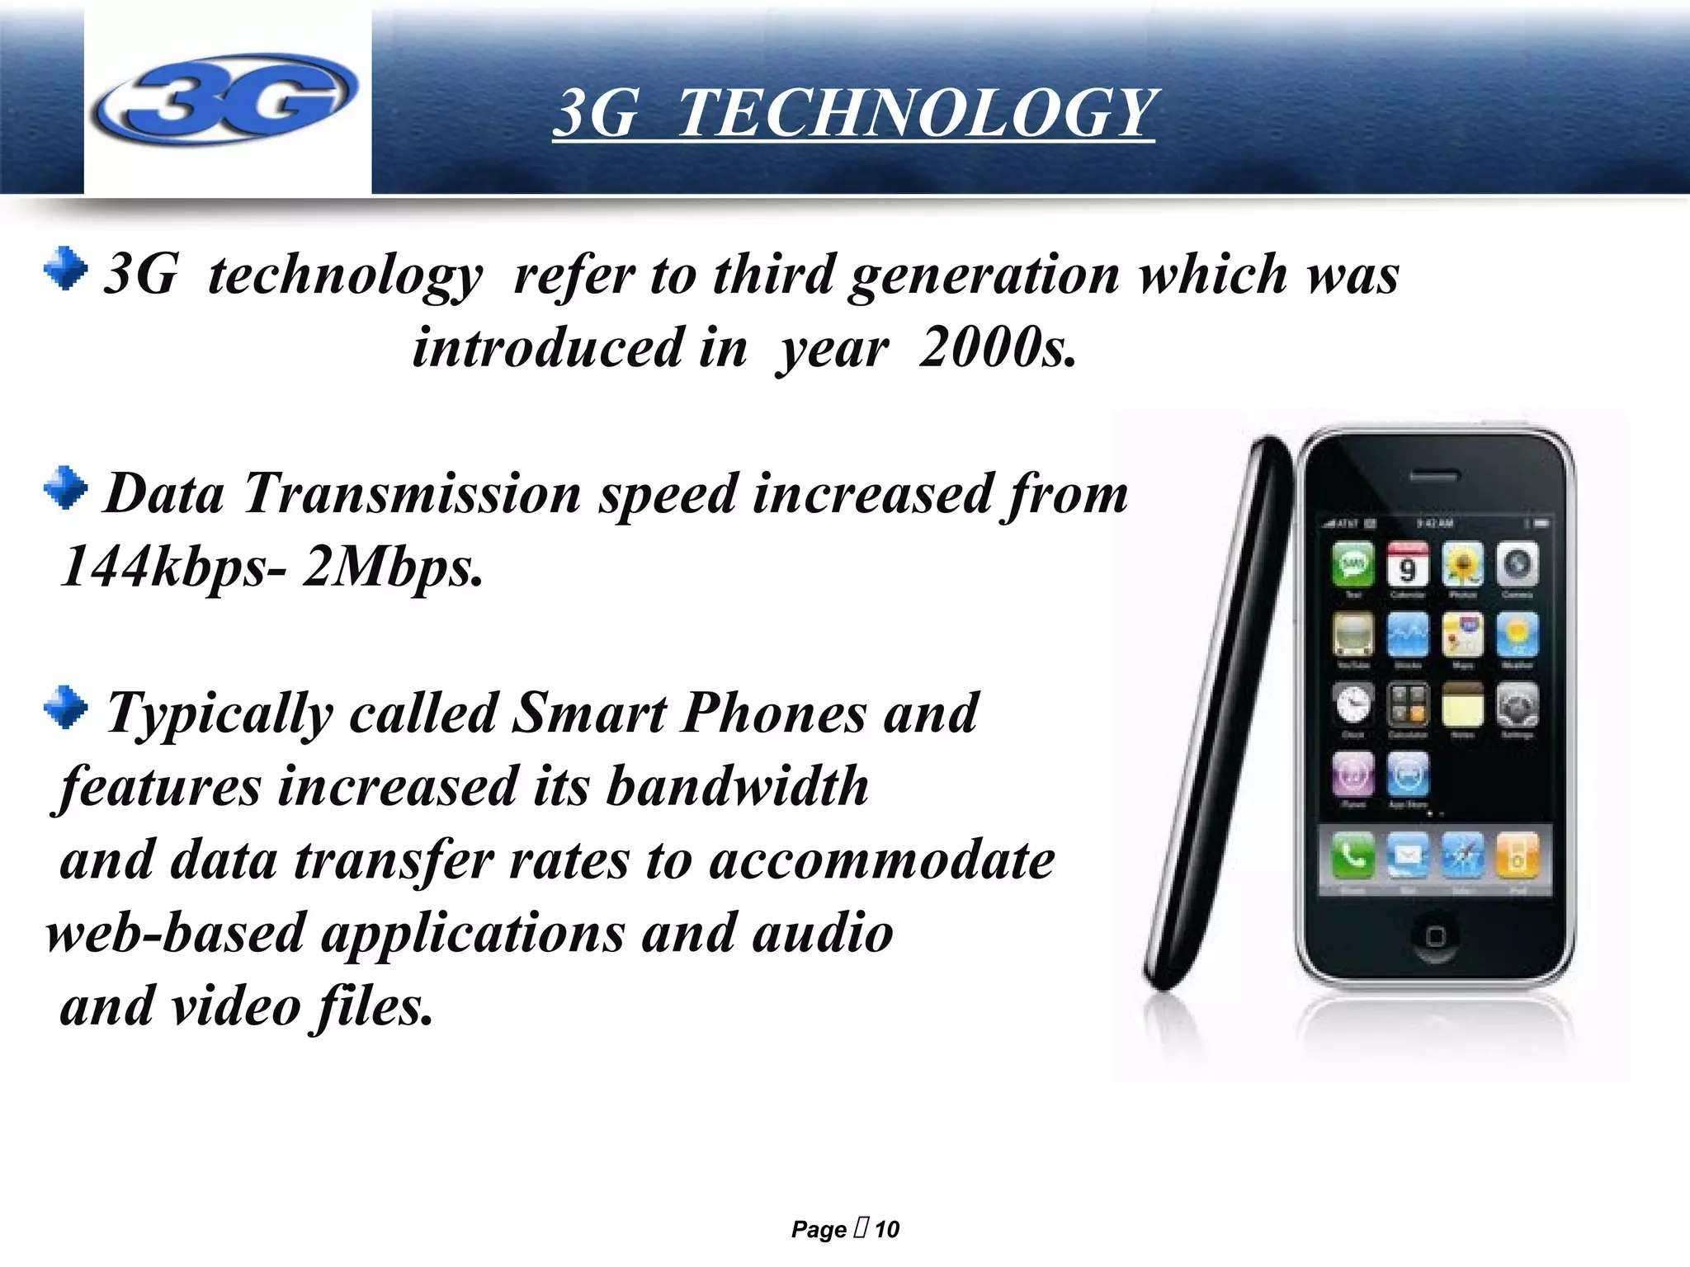

Slide 13
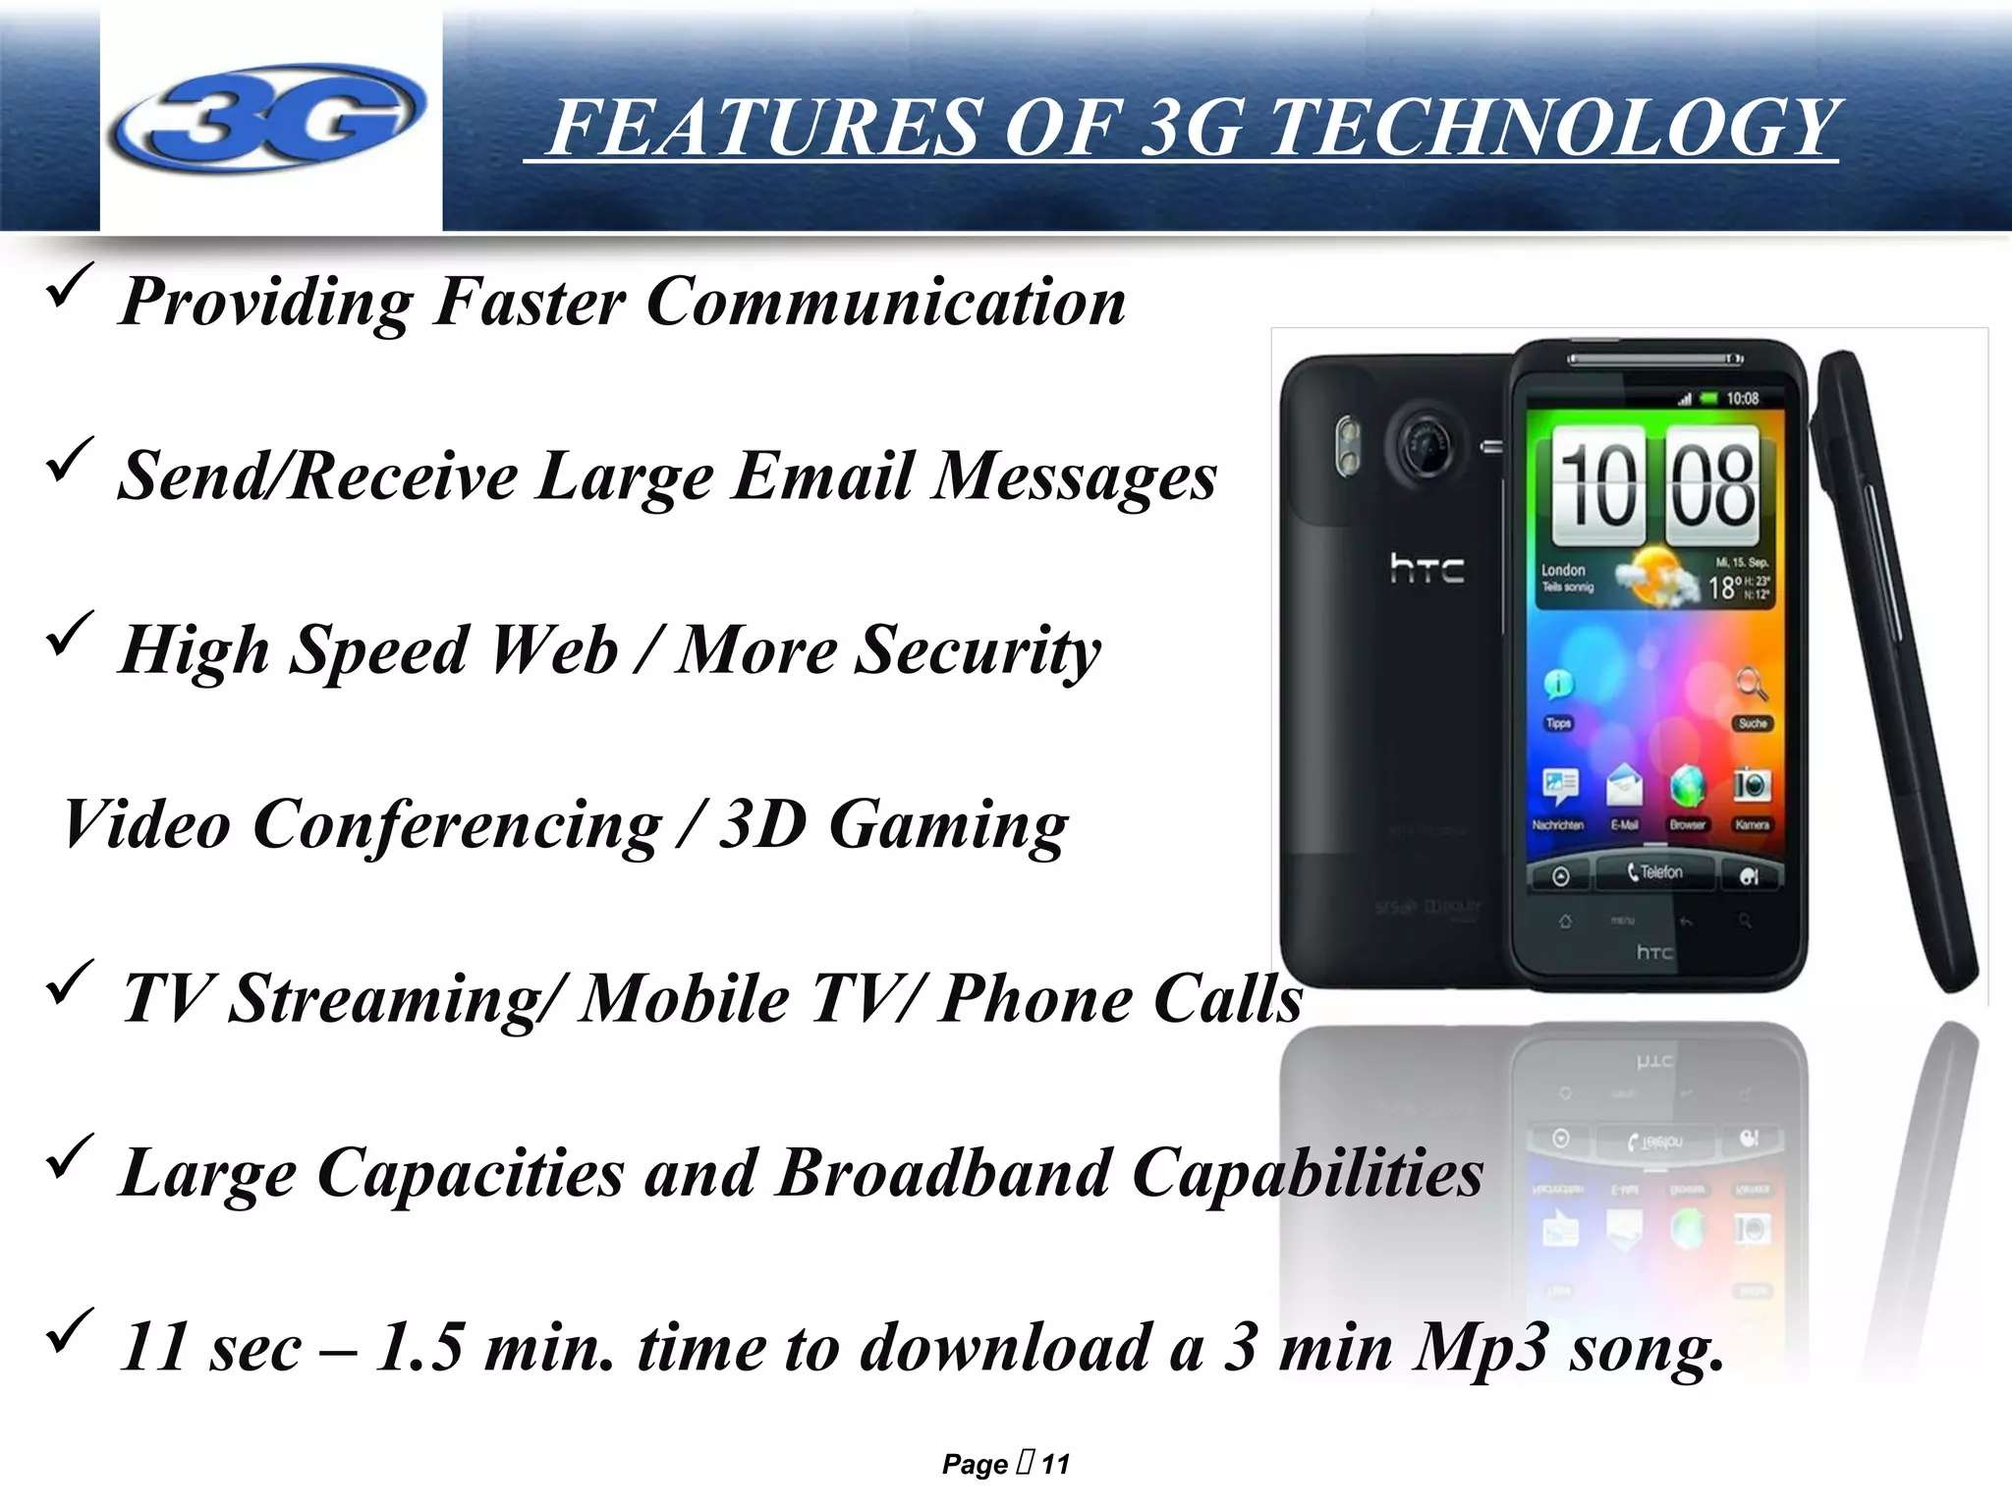

Slide 14
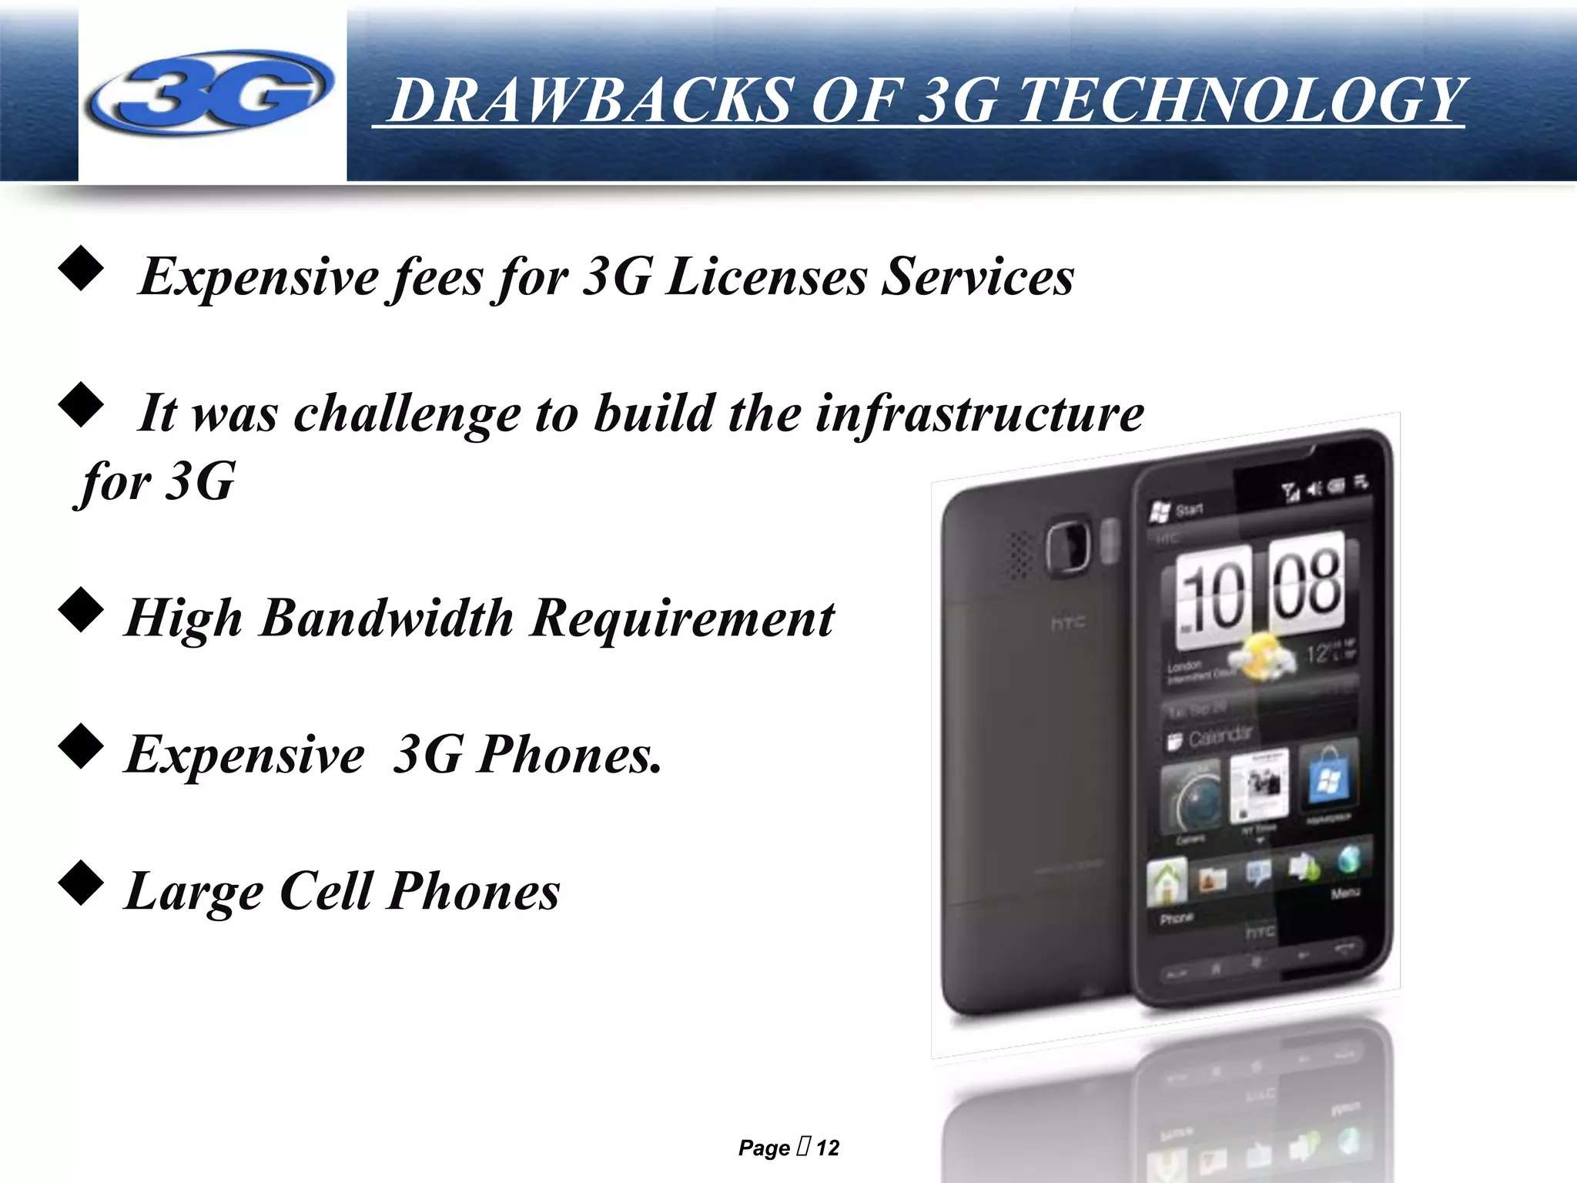

Slide 15
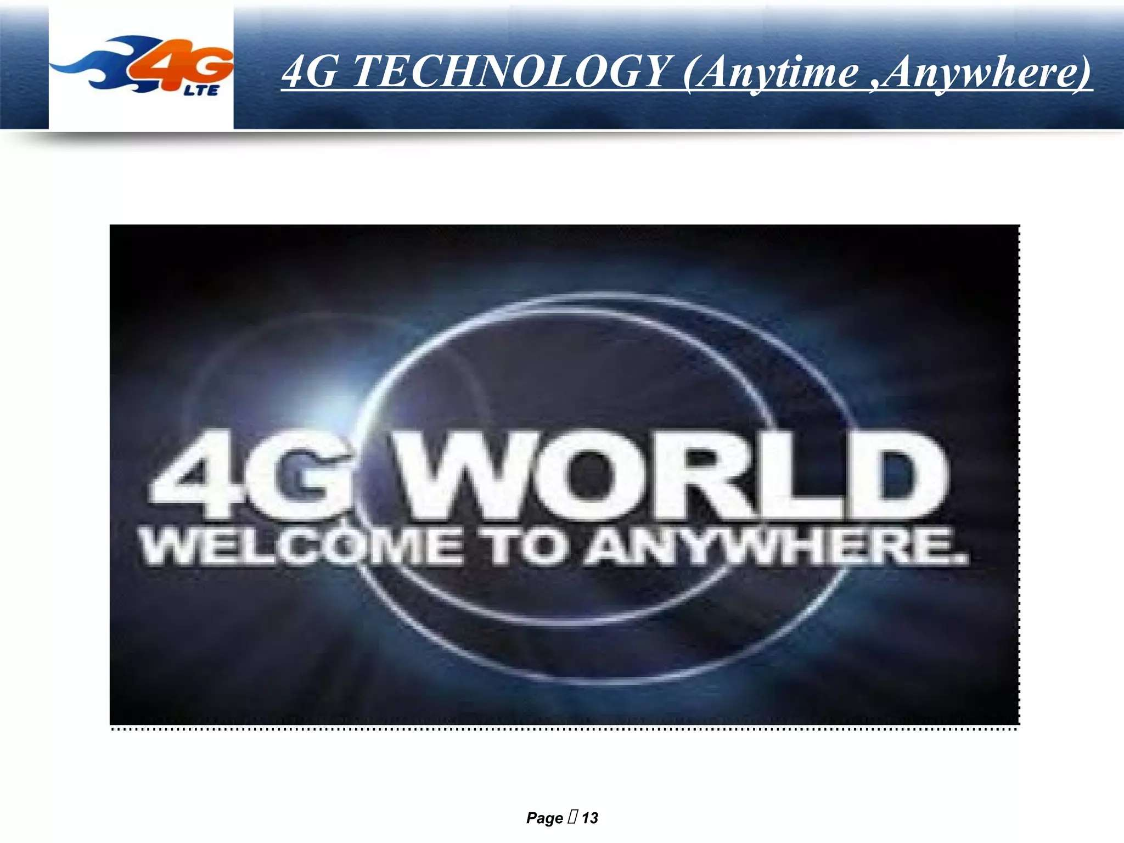

Slide 16
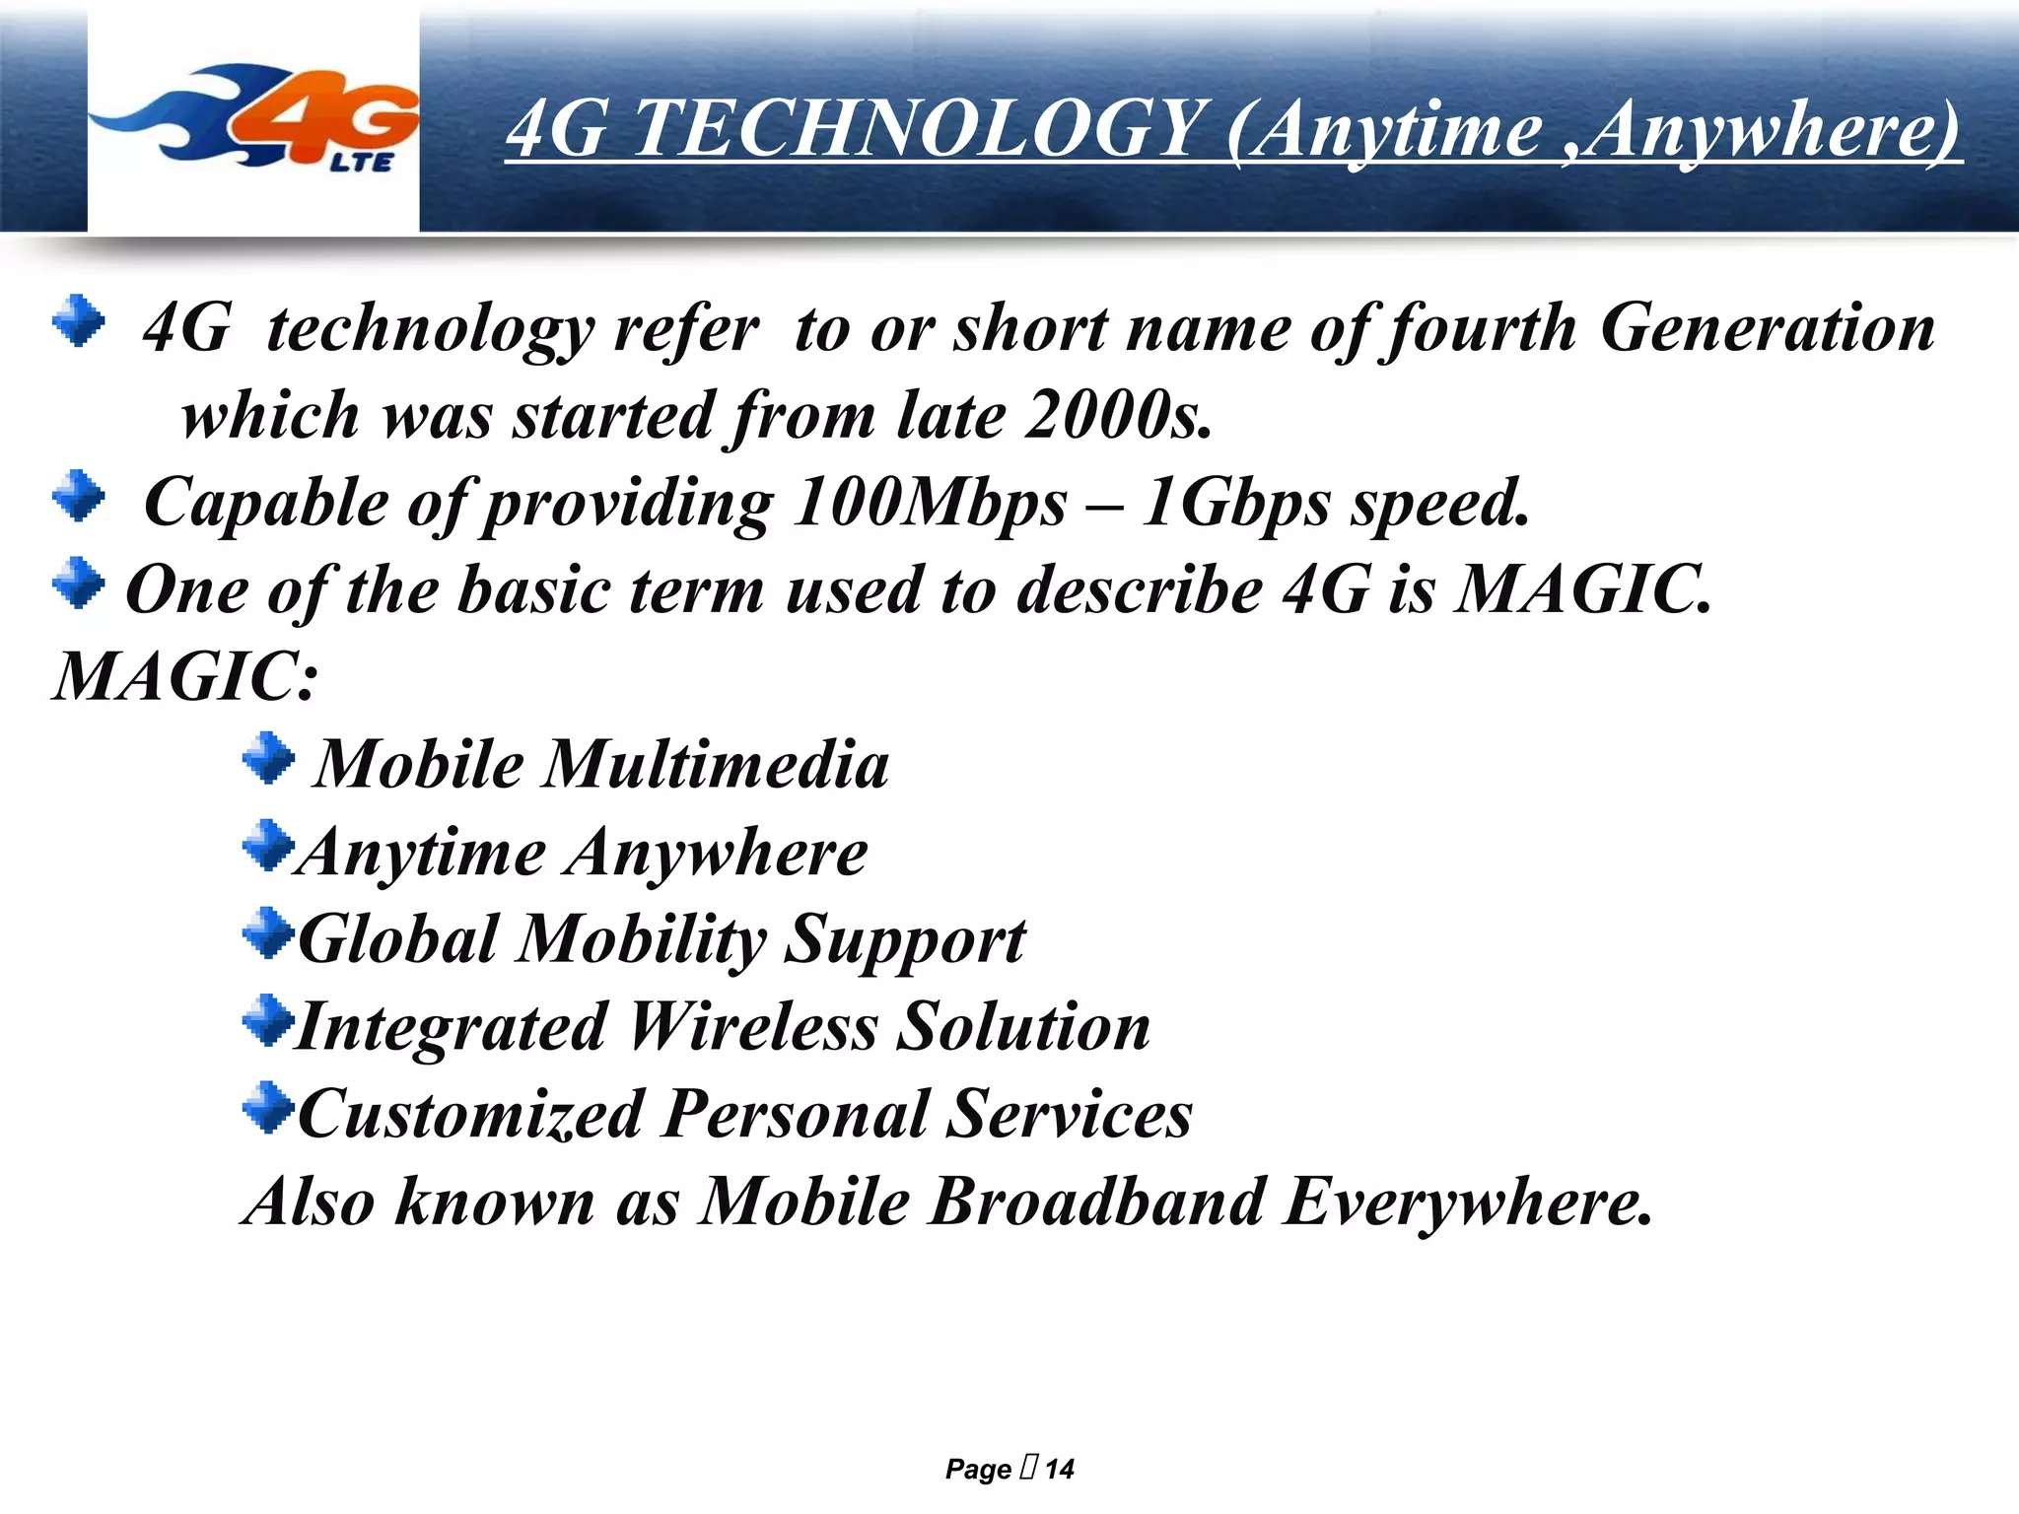

Slide 17
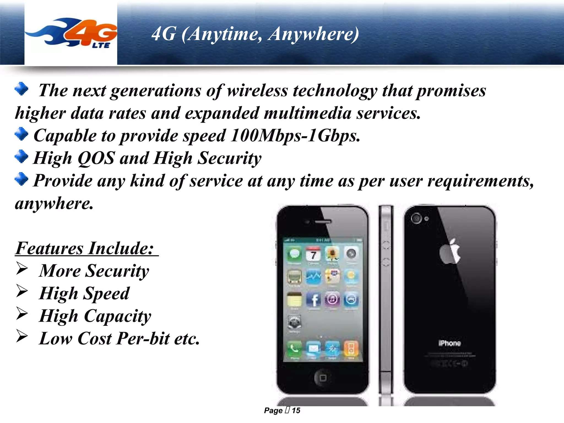

Slide 18
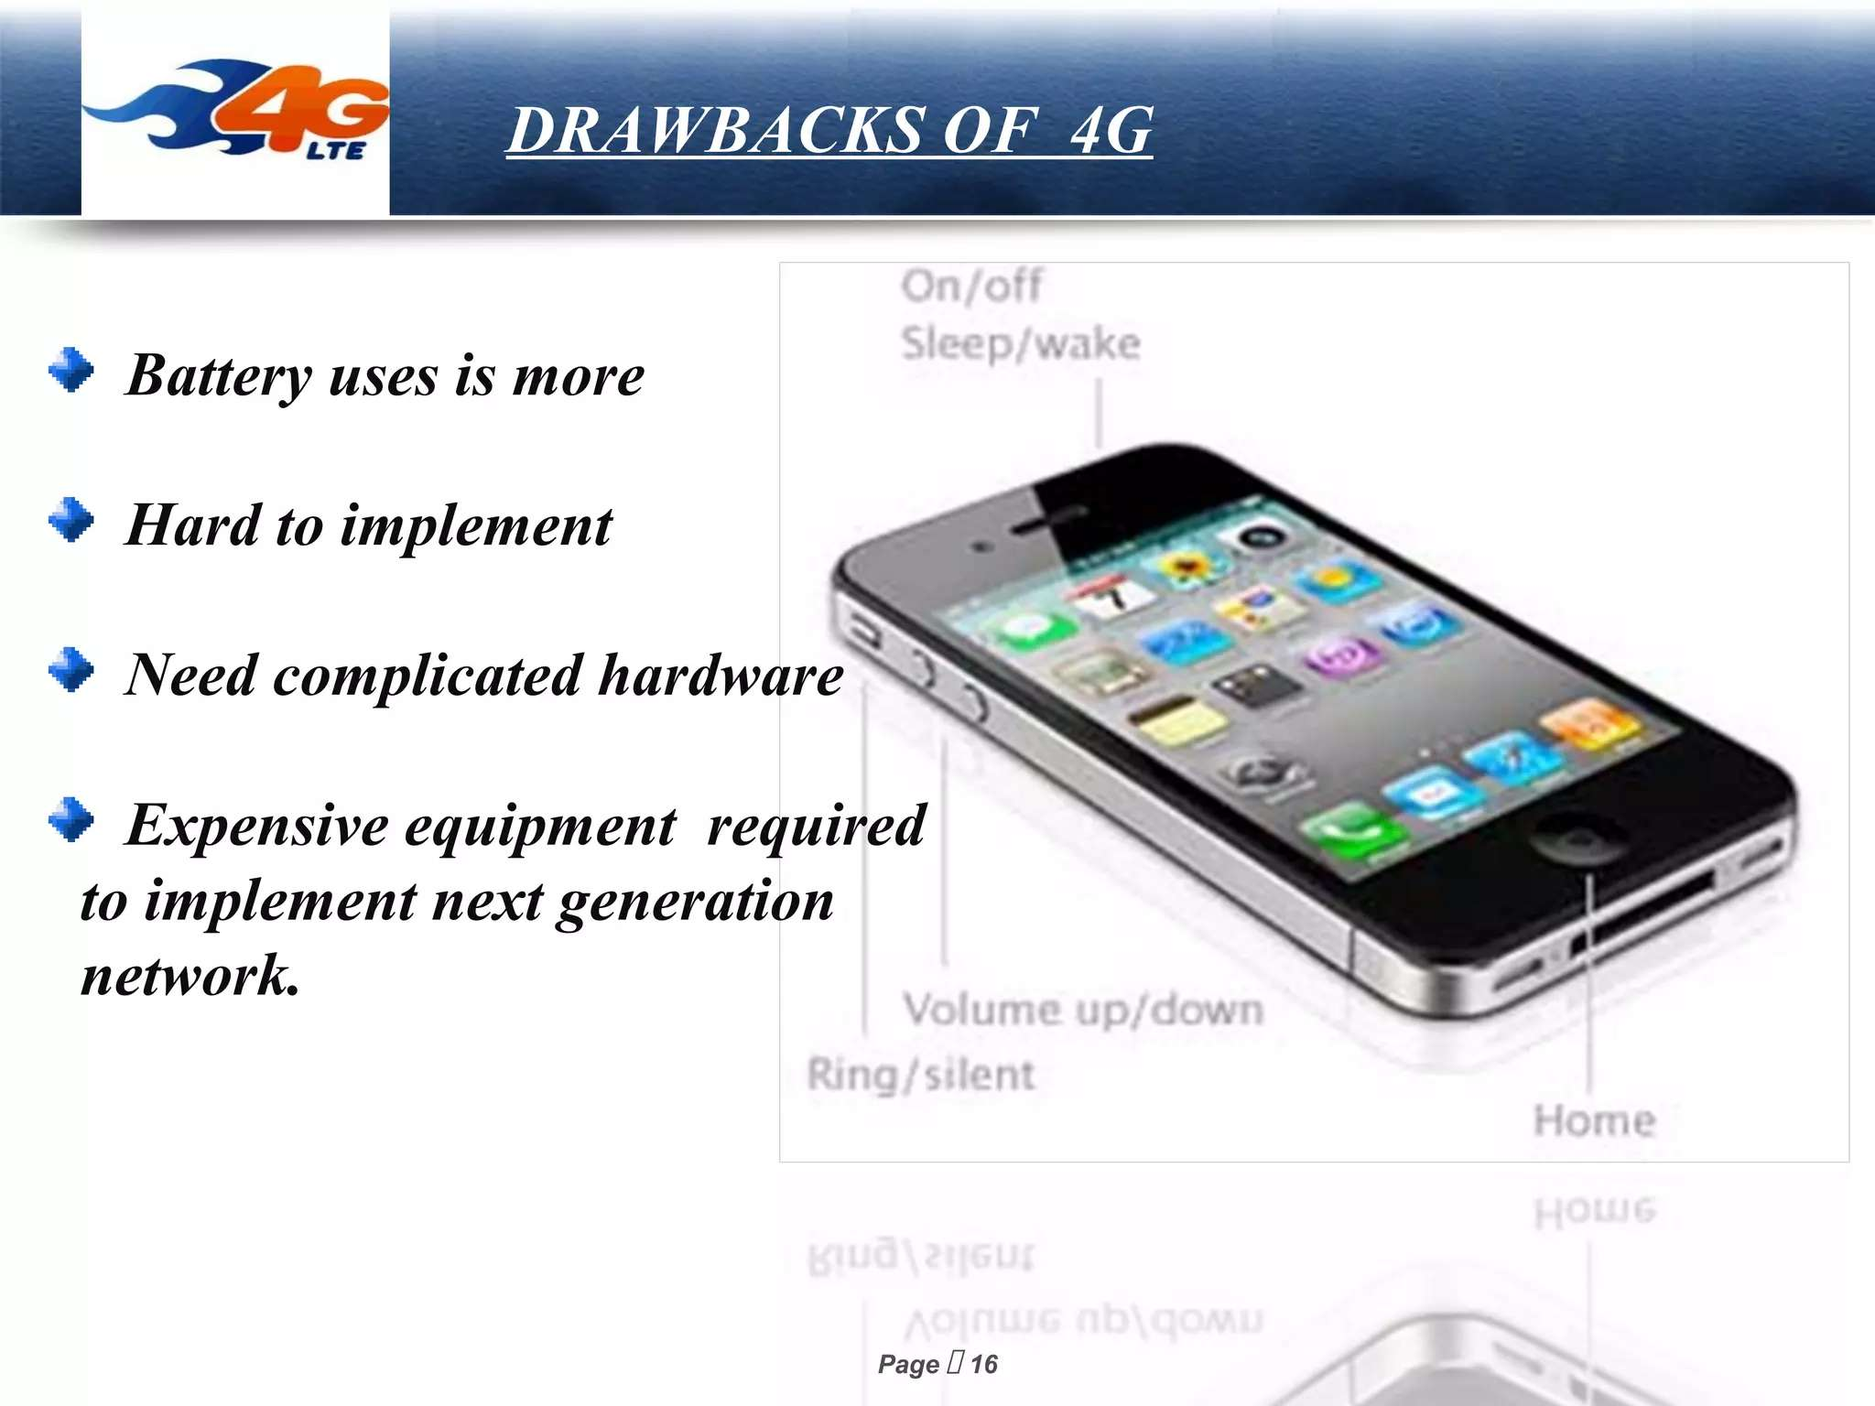

Slide 19
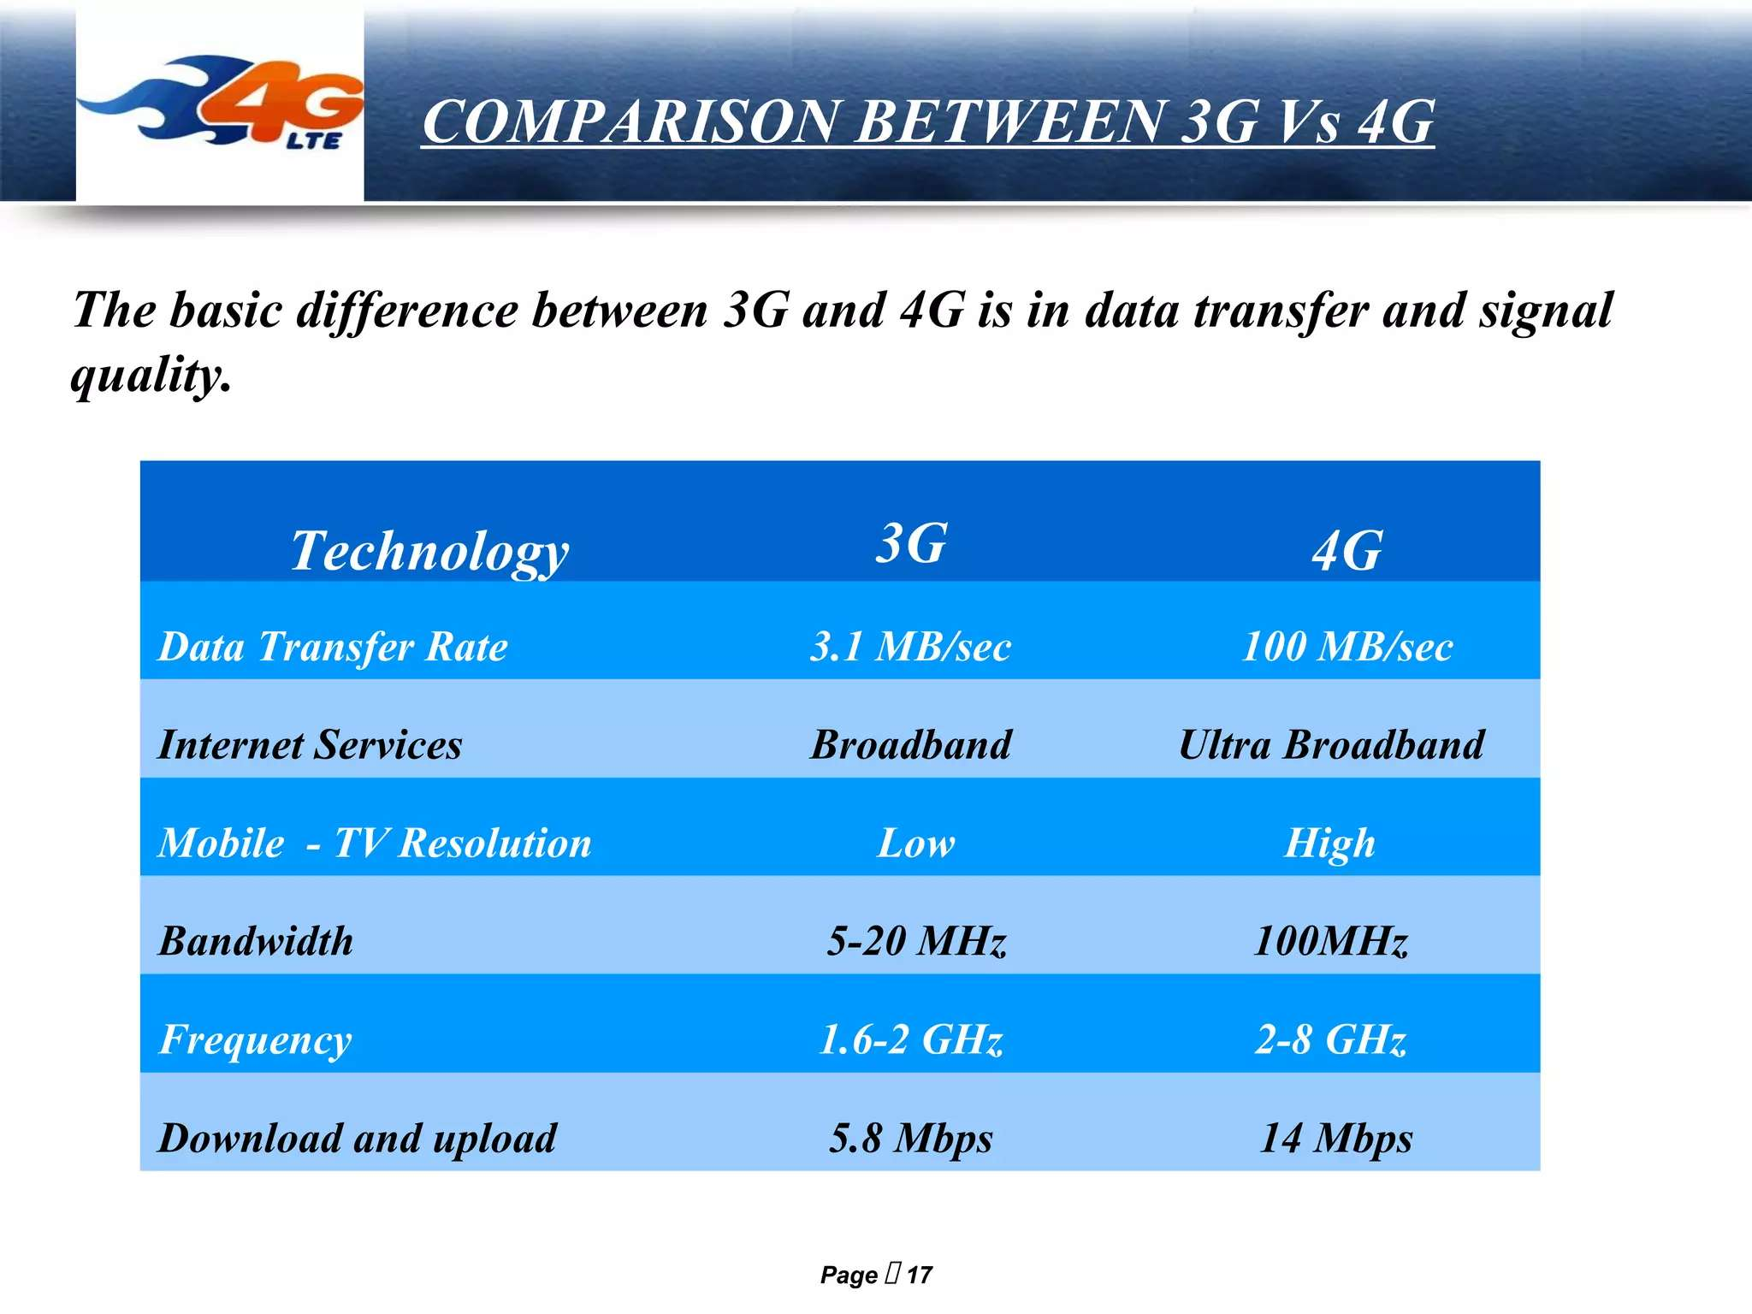

Slide 20
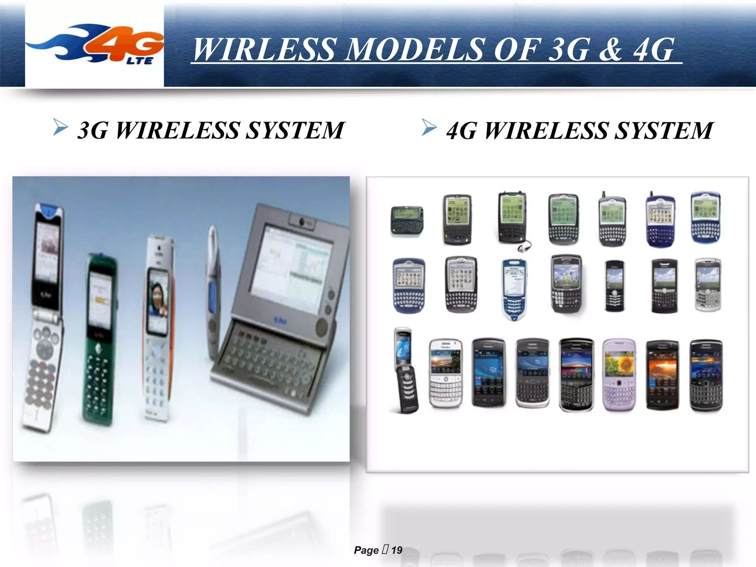

Slide 21
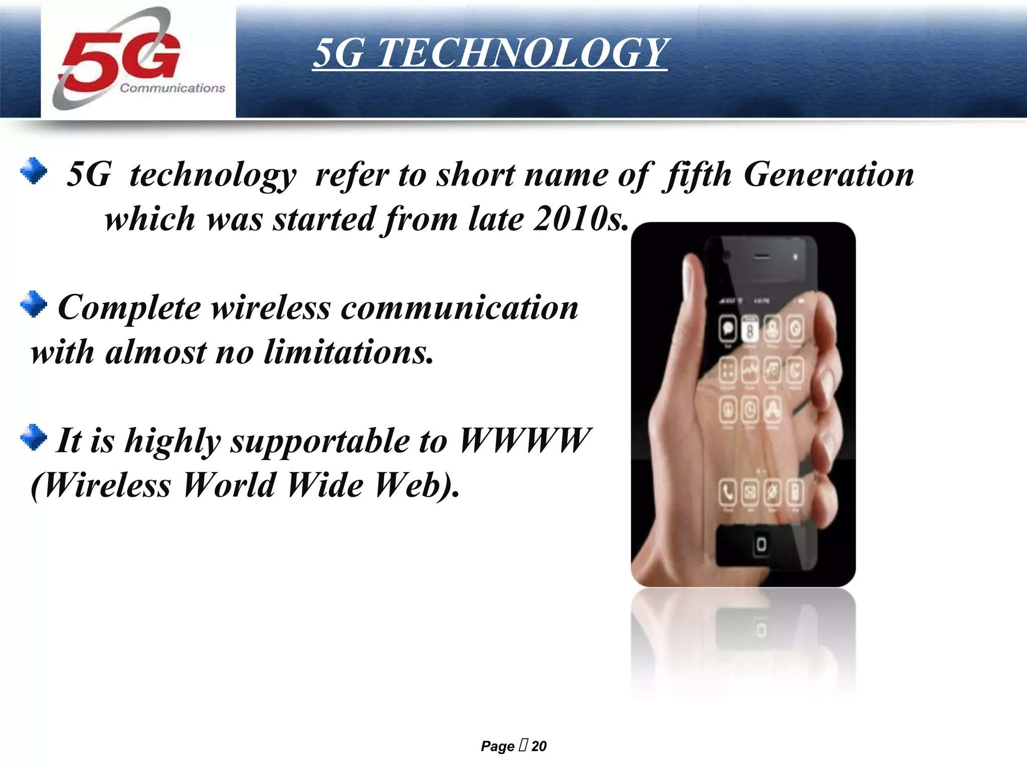

Slide 22
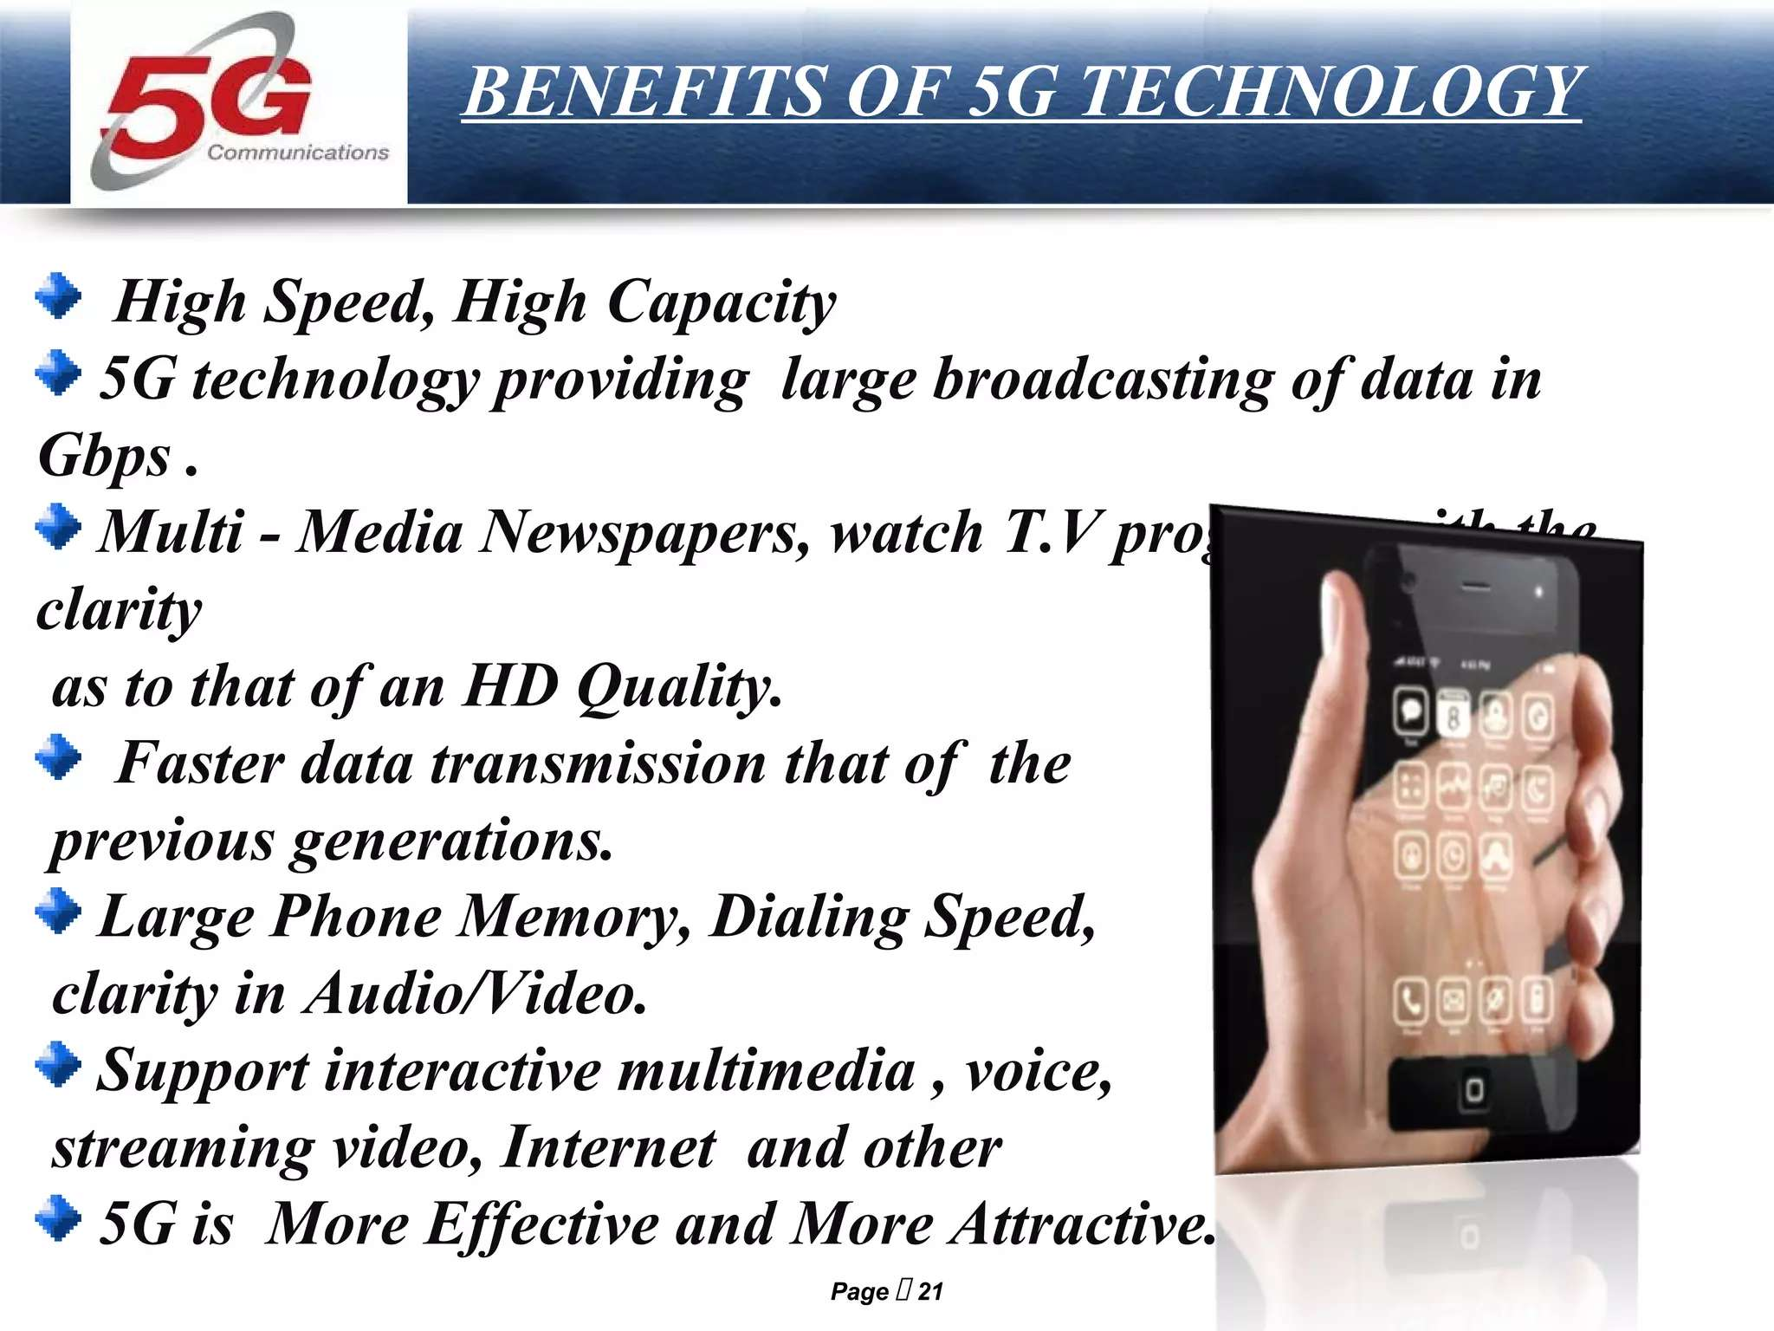

Slide 23
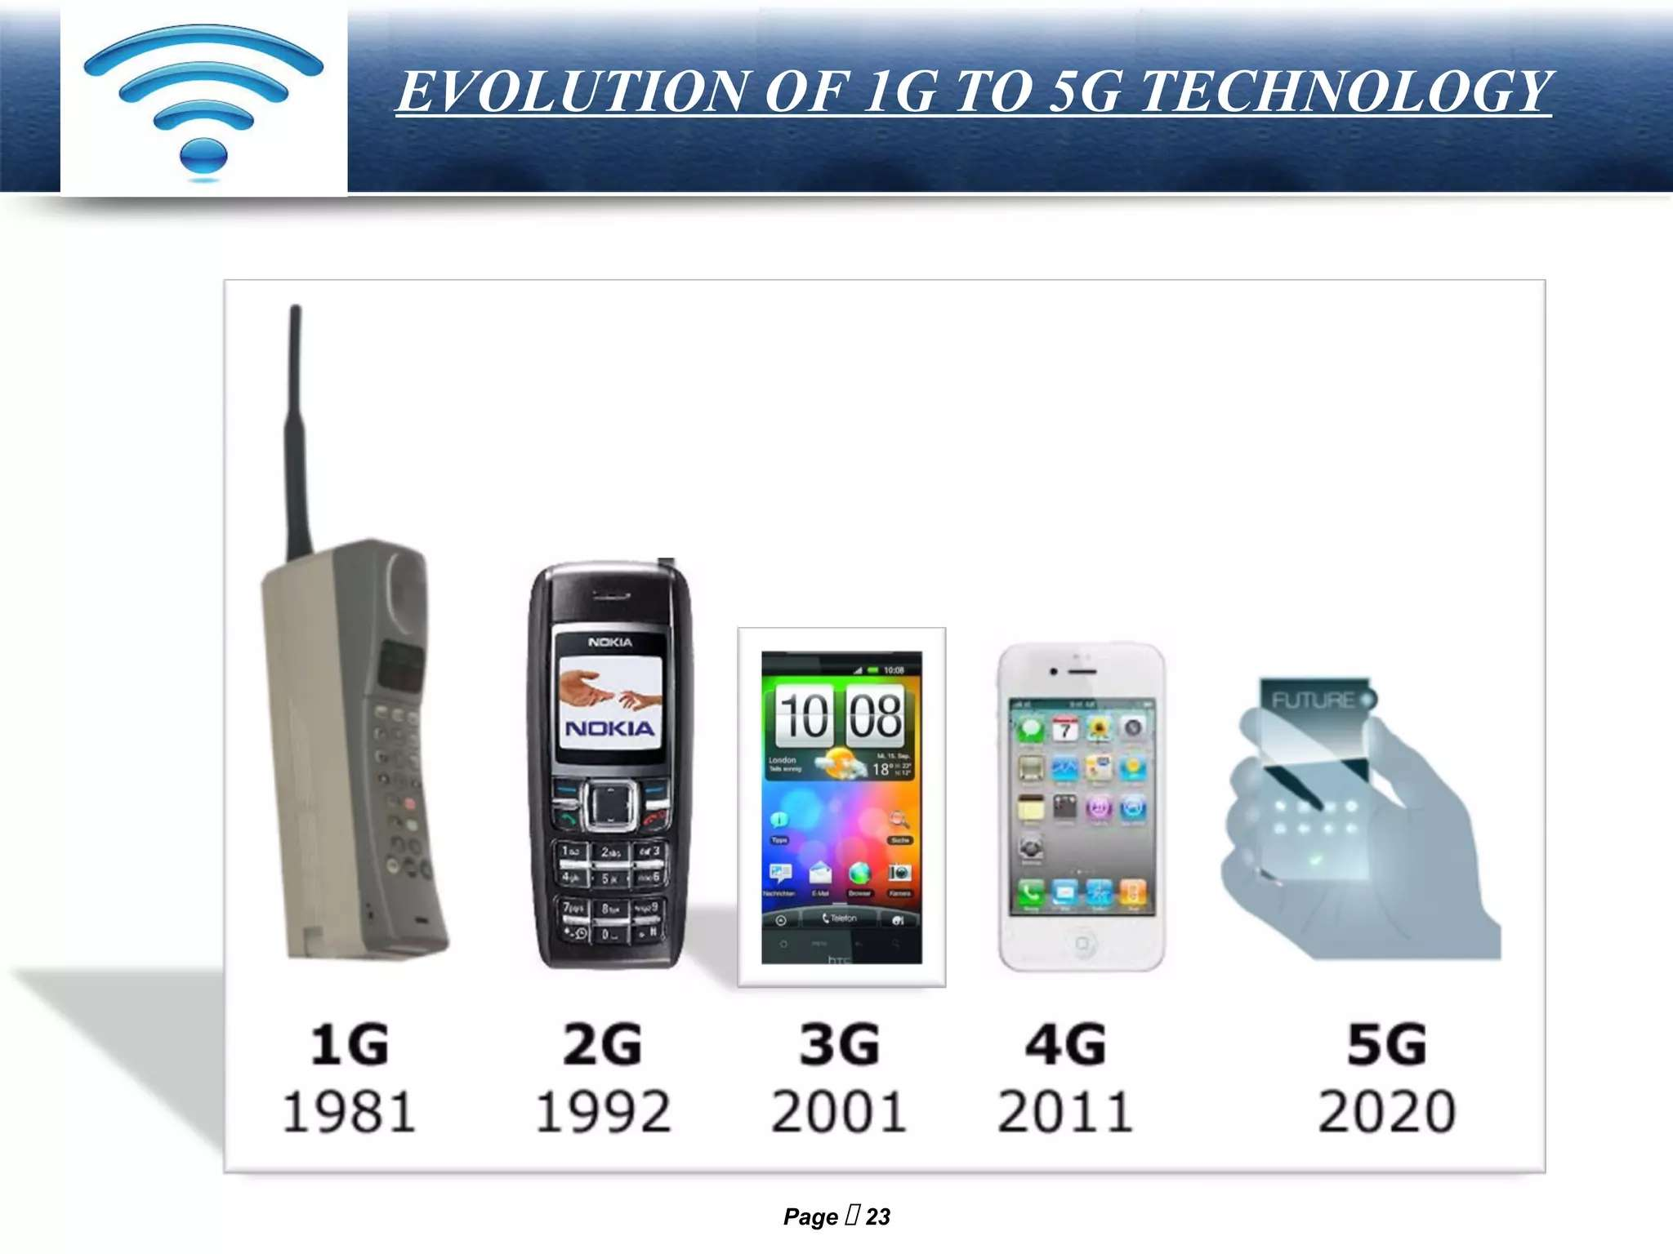

Slide 24
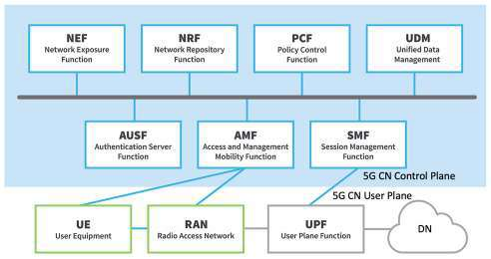
Architecture of 5G Network

Slide 25
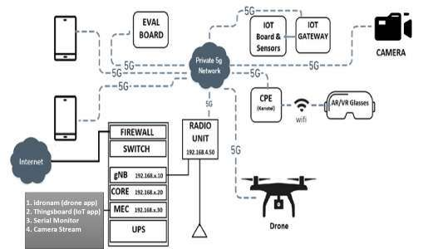
5G Use case Lab Configuration at IIIT, KALYANI

Slide 26
Limitation of 5G and advantage of 6G
Antenna is embdded in 5G Mobile and not Visible to Human
IT USES omni-directional having 360 degree radiation pattern( essential and desired)
6G avoiding this limitation and uses Smart antenna

Slide 27
Outline of Presentation
Mobile Generations from 1G to 5G
5G Smart ANT_Beamforming
Commercial availability of smart antenna for 5g/6G mobile uses
What is Smart antenna?
Types
Advantages and Limitation
Smart Antenna Uses in ofdm and 5G/6G

Slide 28
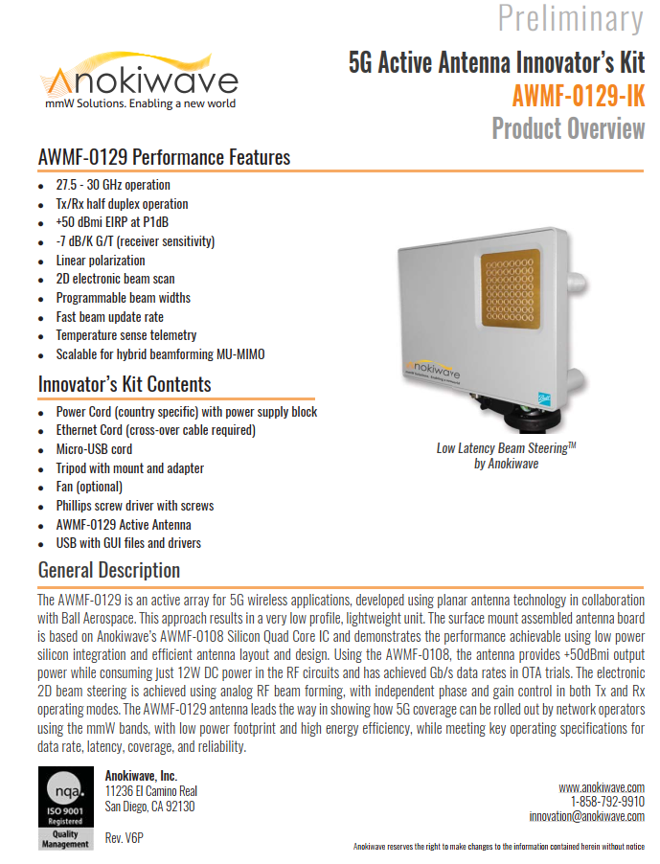

Slide 29
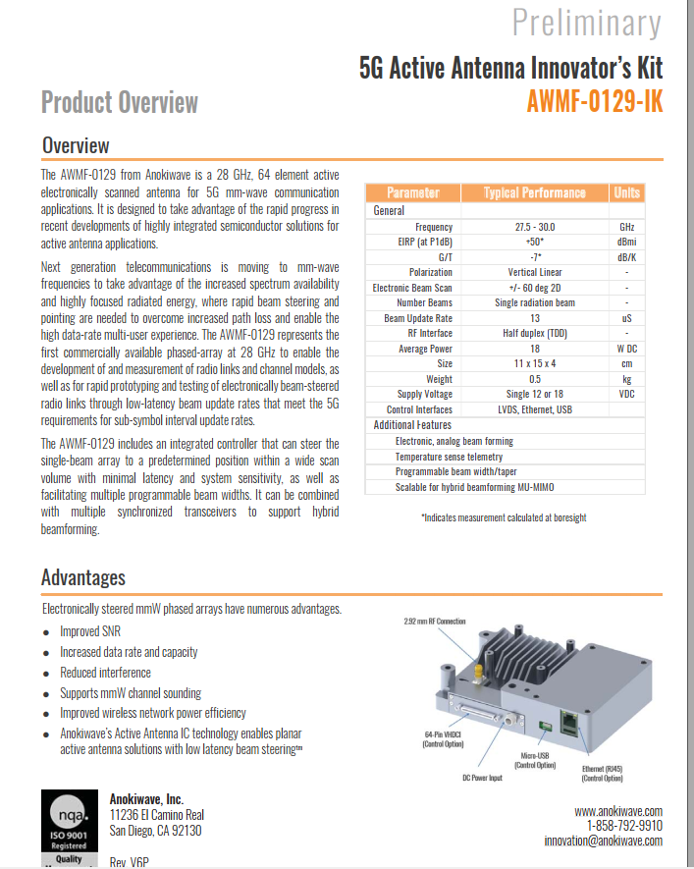

Slide 30
SMART ANTENNAS as SPATIAL FILTERING
Input radio signals to Smart Antennas based RECEIVER : Output signal from smart ant after Signal processing
1. Signal 2. Noise 3. Interference Only SIgnal ; Noise and Interference Rejected leading to Enhanced System Performance

Slide 35
Types of Smart Antenna
:- Best USES for 5G/6G Base Station
:- Best USES for 5G/6G Mobile user

Slide 37
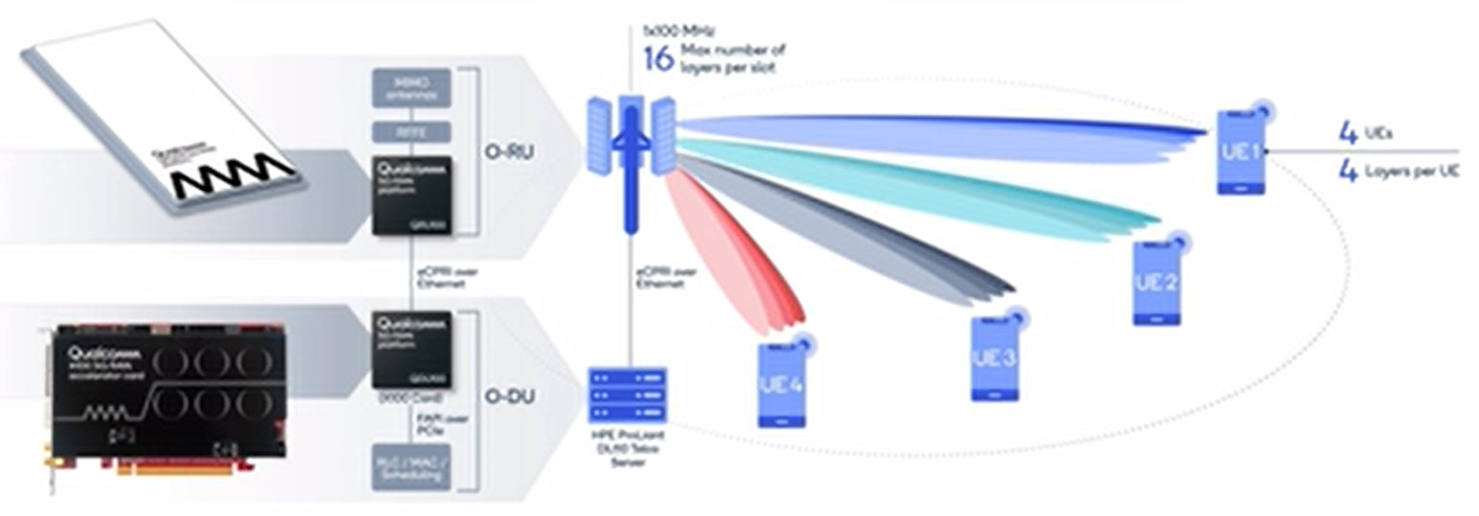
QUALCOMM O-RAN with SMART ANTENNA Beamforming and providing Highest Radio Energy Efficiency

Slide 38
QUALCOMM O-RAN with SMART ANTENNA Beamforming and providing Highest Radio Energy Efficiency

Slide 39
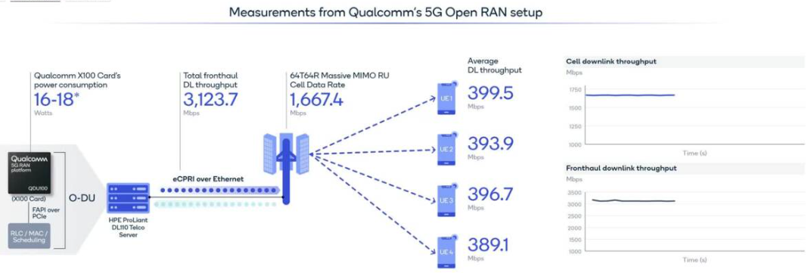
https://www.5gtechnologyworld.com/what-is-5g-femto-application-platform-interface-5g-fapi-faq/

Slide 40
**DESIRED SIGNAL PEAKING and
INTERFERENCE NULLING
Best USES for 5G/6G Mobile user

Slide 42


SYNCRONISATION in SPACE DOMAIN
12/23

